Slide 1
Econ 645: Week 9
Limited Dependent Variables Part II
Poisson and Negative Binomial Estimators
Censored and Truncated Regression Models
Sample Selection Correction

Slide 2
Overview
Nonnegative Numbers
Poisson
Negative Binomial
Censored and Truncated Regressions
Censored Regression Model
Truncated Regression Model
Sample Selection
Incidental Truncation
Heckit Method

Slide 3
Poisson Estimator
Long and Freese (2014)

Slide 4
Poisson
What happens when we have a nonnegative count variable
Unlike Corner solution, we don’t have a nonnegative continuous variable
We have a distribution of nonnegative integers
Examples
Number of children
Number of arrests
Number of patents
An OLS estimator may not be the most appropriate model
Similar to Tobit, we cannot take the logarithm since we have a bunch of zeros

Slide 5
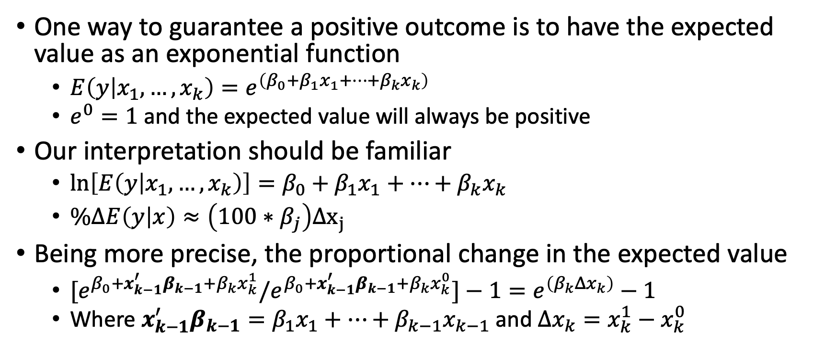
Poisson
One way to guarantee a positive outcome is to have the expected value as an exponential function
$E\left(y | x_{1},…,x_{k}\right)=e^{\left(β_{0}+β_{1}x_{1}+…+β_{k}x_{k}\right)}$
$e^{0}=1$ and the expected value will always be positive
Our interpretation should be familiar
$\ln\left[E\left(y | x_{1},…,x_{k}\right)\right]=β_{0}+β_{1}x_{1}+…+β_{k}x_{k}$
$\%ΔE\left(y | x\right)≈\left(100∗β_{j}\right)Δx_{j}$
Being more precise, the proportional change in the expected value
${[e}^{β_{0}+x_{k−1}^{′}β_{k−1}+β_{k}x_{k}^{1}}/e^{β_{0}+x_{k−1}^{′}β_{k−1}+β_{k}x_{k}^{0}}]−1=e^{\left(β_{k}Δx_{k}\right)}−1$
Where $x_{k−1}^{′}β_{k−1}=β_{1}x_{1}+…+β_{k−1}x_{k−1}$ and $Δx_{k}=x_{k}^{1}−x_{k}^{0}$

Slide 6
Poisson
The expected value being an exponential function
It provides elasticities, which provide helpful interpretations
Similar to our log-linear models in OLS
One problem with the expected value being a exponential function
Exponent is a nonlinear in parameters
We will need the maximum likelihood estimator, and
We will need to use the related quasi-maximum likelihood estimator
We need a Poisson Distribution for our count data
This is different from our normality assumption in OLS
Count variables are not continuous and normally distributed

Slide 7
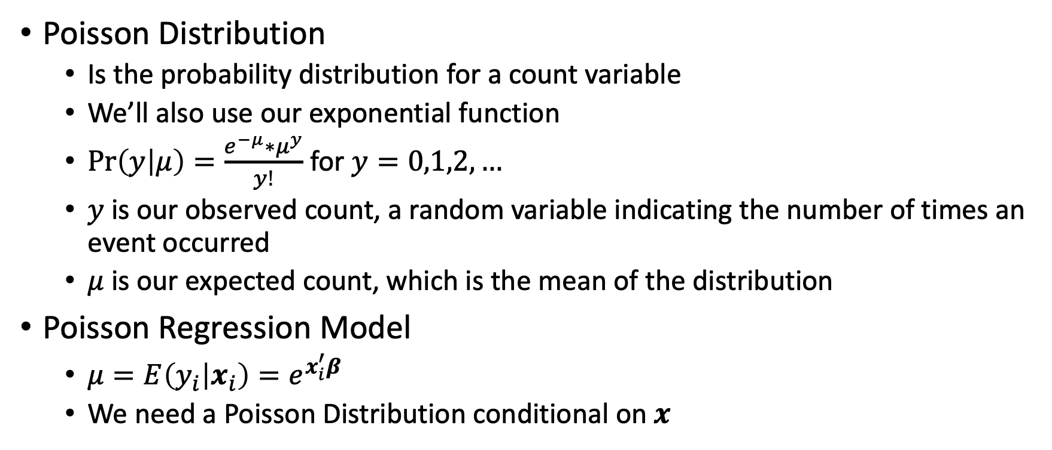
Poisson
Poisson Distribution
Is the probability distribution for a count variable
We’ll also use our exponential function
$\operatorname{Pr}\left(y | μ\right)=\frac{e^{−μ}∗μ^{y}}{y!}$ for $y=0,1,2,…$
$y$ is our observed count, a random variable indicating the number of times an event occurred
$μ$ is our expected count, which is the mean of the distribution
Poisson Regression Model
$μ=E\left(y_{i} | x_{i}\right)=e^{x_{i}^{′}β}$
We need a Poisson Distribution conditional on $x$

Slide 8
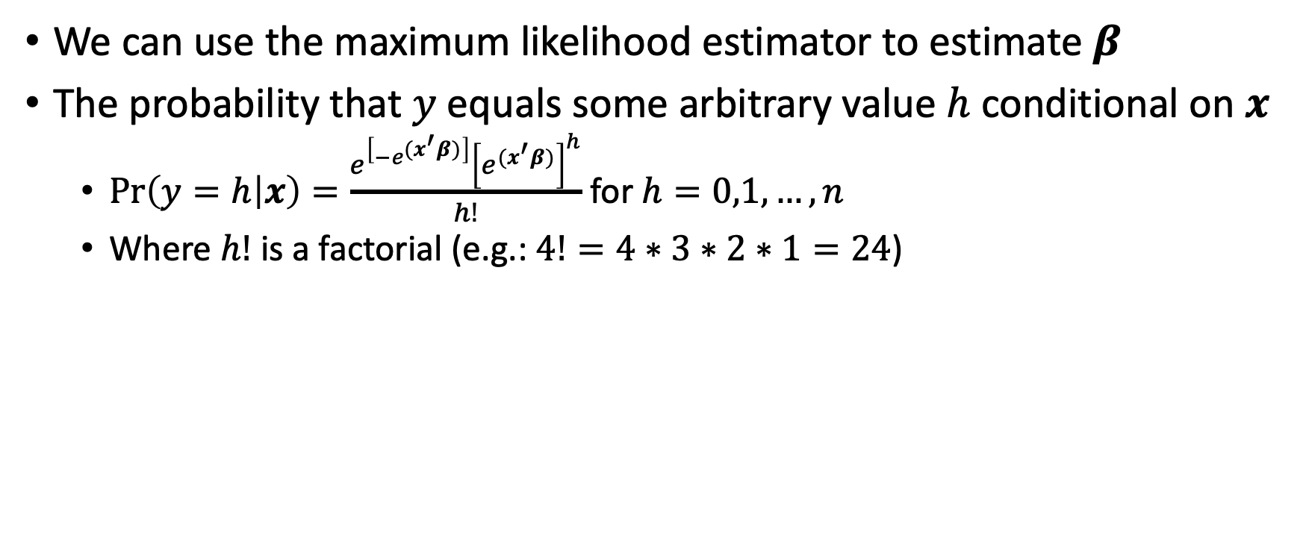
Poisson
We can use the maximum likelihood estimator to estimate $β$
The probability that $y$ equals some arbitrary value $h$ conditional on $x$
$\operatorname{Pr}\left(y=h | x\right)=\frac{e^{\left[−e^{{(x}^{′}β)}\right]}{\left[e^{{(x}^{′}β)}\right]}^{h}}{h!}$ for $h=0,1,…,n$
Where $h!$ is a factorial (e.g.: $4!=4∗3∗2∗1=24$)

Slide 9
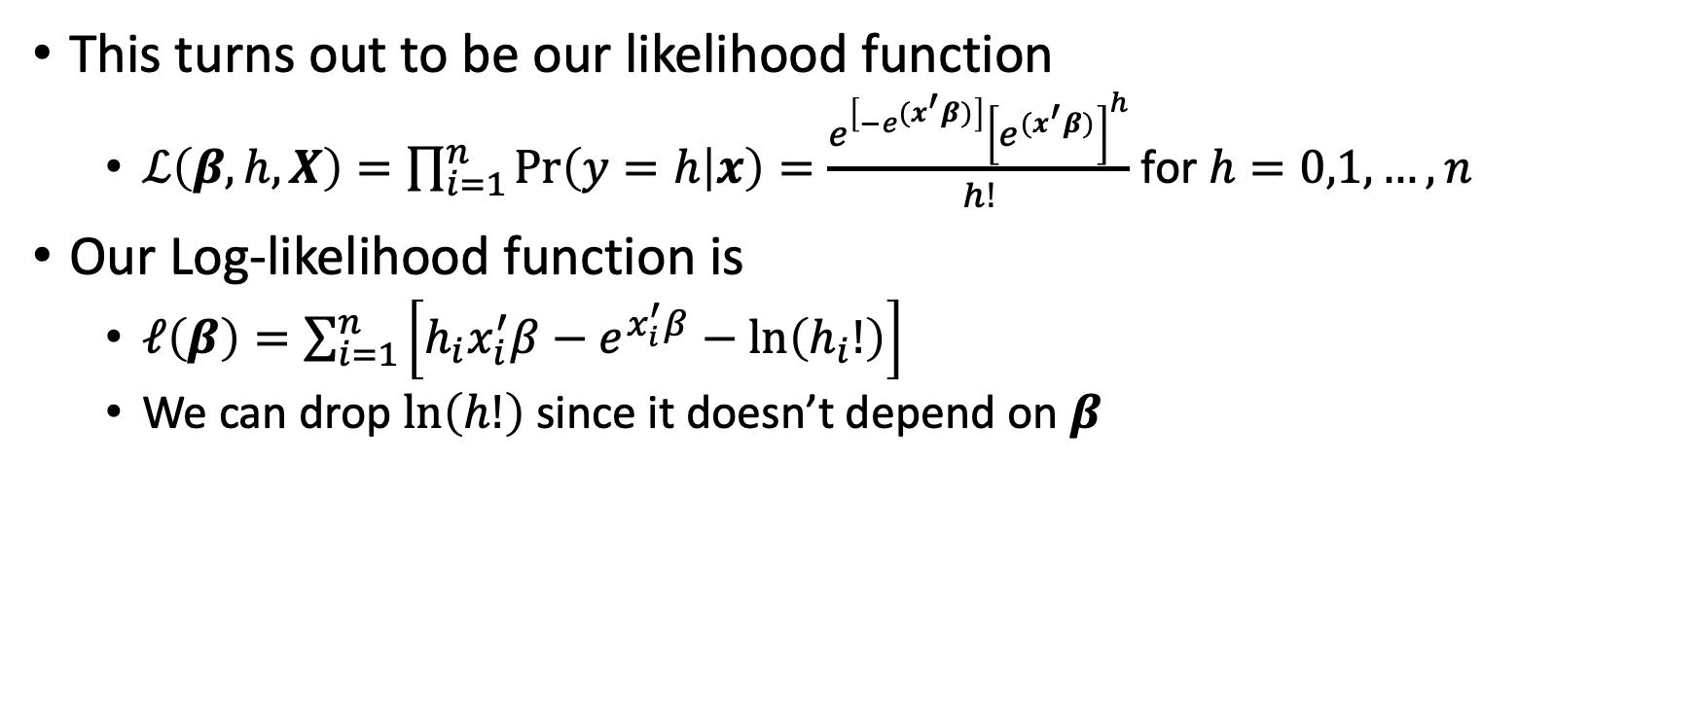
Poisson
This turns out to be our likelihood function
$ℒ\left(β,h,X\right)=\prod_{i=1}^{n}{\operatorname{Pr}\left(y=h | x\right)=\frac{e^{\left[−e^{{(x}^{′}β)}\right]}{\left[e^{{(x}^{′}β)}\right]}^{h}}{h!}}$ for $h=0,1,…,n$
Our Log-likelihood function is
$ℓ\left(β\right)=\sum_{i=1}^{n}{\left[h_{i}x_{i}^{′}β−e^{x_{i}^{′}β}−\ln\left(h_{i}!\right)\right]}$
We can drop $\ln\left(h!\right)$ since it doesn’t depend on $β$

Slide 10
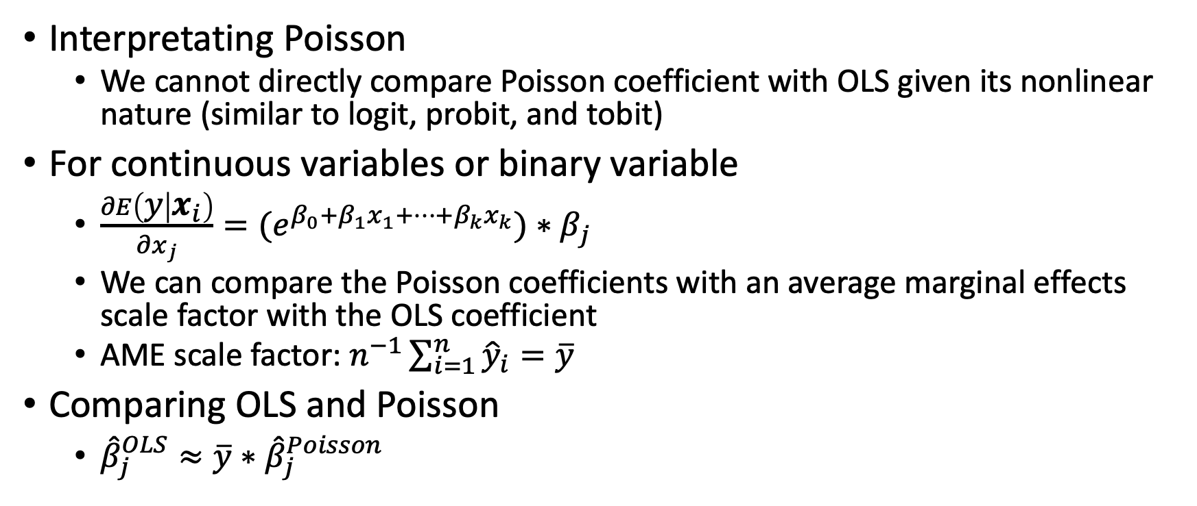
Interpreting Poisson
Interpretating Poisson
We cannot directly compare Poisson coefficient with OLS given its nonlinear nature (similar to logit, probit, and tobit)
For continuous variables or binary variable
$\frac{∂E\left(y | x_{i}\right)}{∂x_{j}}={(e}^{β_{0}+β_{1}x_{1}+…+β_{k}x_{k}})∗β_{j}$
We can compare the Poisson coefficients with an average marginal effects scale factor with the OLS coefficient
AME scale factor: $n^{−1}\sum_{i=1}^{n}{{\hat{y}}_{i}=\overline{y}}$
Comparing OLS and Poisson
${\hat{β}}_{j}^{OLS}≈\overline{y}∗{\hat{β}}_{j}^{Poisson}$

Slide 11
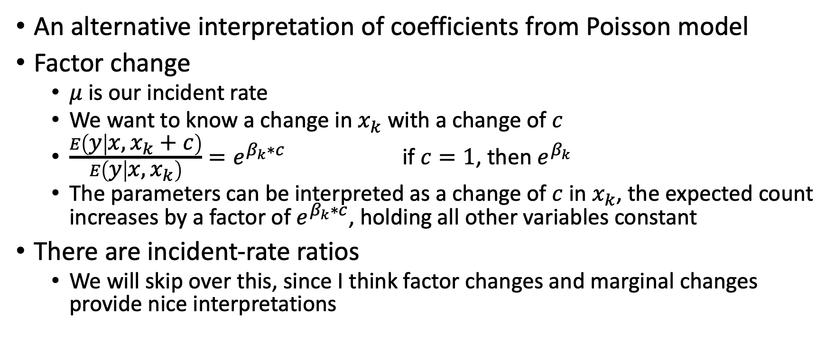
Interpreting Poisson
An alternative interpretation of coefficients from Poisson model
Factor change
$μ$ is our incident rate
We want to know a change in $x_{k}$ with a change of $c$
$\frac{E\left(y | x,x_{k}+c\right)}{E\left(y | x,x_{k}\right)}=e^{β_{k}∗c}$ if $c=1$, then $e^{β_{k}}$
The parameters can be interpreted as a change of $c$ in $x_{k}$, the expected count increases by a factor of $e^{β_{k}∗c}$, holding all other variables constant
There are incident-rate ratios
We will skip over this, since I think factor changes and marginal changes provide nice interpretations

Slide 12
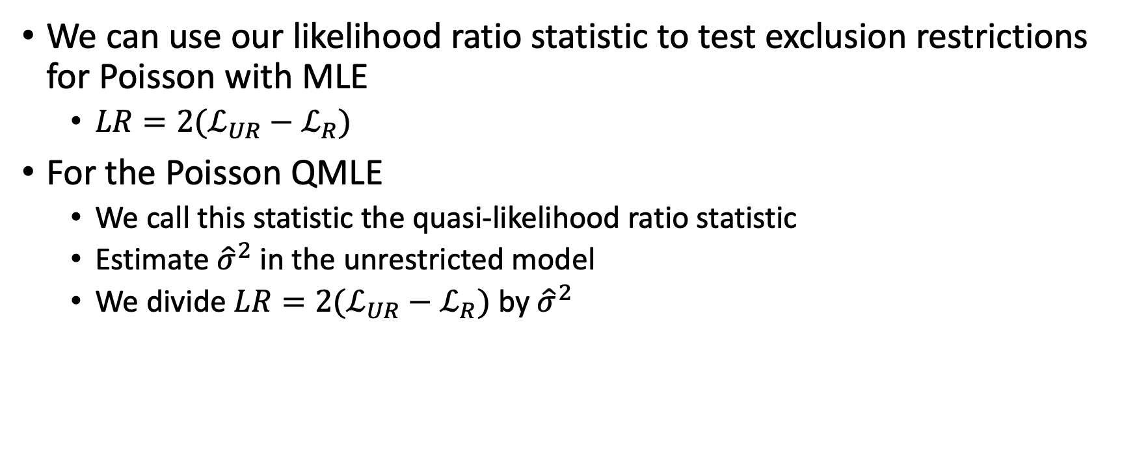
Exclusive Restriction Tests
We can use our likelihood ratio statistic to test exclusion restrictions for Poisson with MLE
$LR=2(ℒ_{UR}−ℒ_{R})$
For the Poisson QMLE
We call this statistic the quasi-likelihood ratio statistic
Estimate ${\hat{σ}}^{2}$ in the unrestricted model
We divide $LR=2(ℒ_{UR}−ℒ_{R})$ by ${\hat{σ}}^{2}$

Slide 13
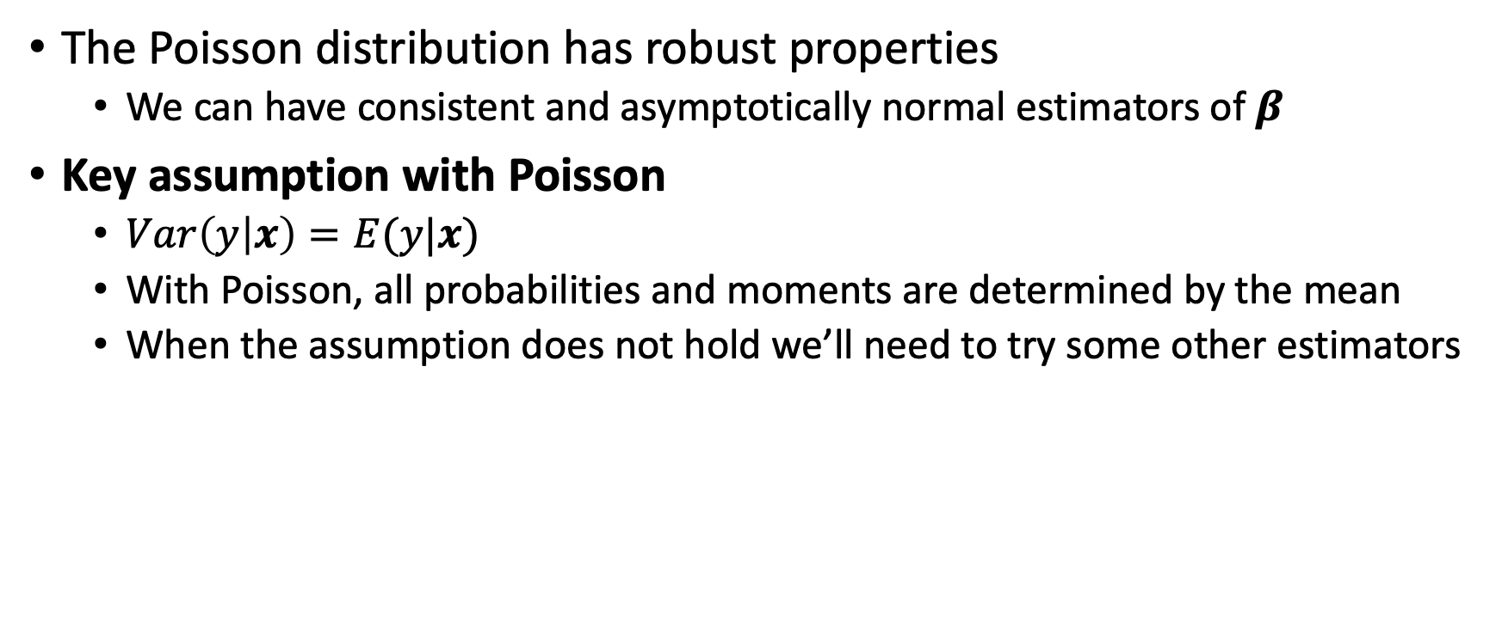
Poisson Properties and Assumptions
The Poisson distribution has robust properties
We can have consistent and asymptotically normal estimators of $β$
Key assumption with Poisson
$Var\left(y | x\right)=E(y|x)$
With Poisson, all probabilities and moments are determined by the mean
When the assumption does not hold we’ll need to try some other estimators

Slide 14
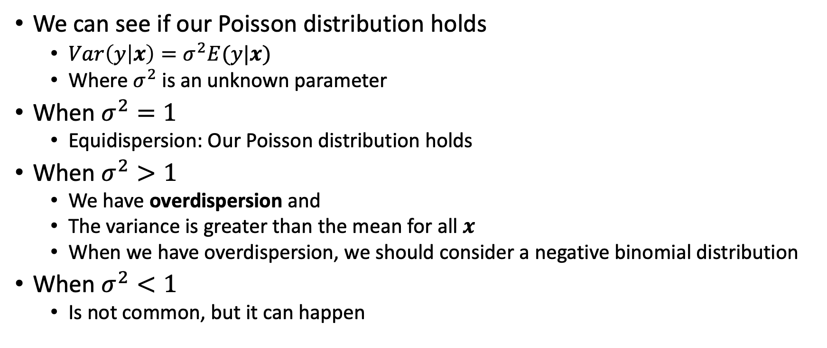
Overdispersion
We can see if our Poisson distribution holds
$Var\left(y | x\right)=σ^{2}E(y|x)$
Where $σ^{2}$ is an unknown parameter
When $σ^{2}=1$
Equidispersion: Our Poisson distribution holds
When $σ^{2}>1$
We have overdispersion and
The variance is greater than the mean for all $x$
When we have overdispersion, we should consider a negative binomial distribution
When $σ^{2}<1$
Is not common, but it can happen

Slide 15
Overdispersion
Testing for overdispersion
We can do this in Stata with estat gof
Our null hypothesis is that the Poisson assumption holds and the Poisson distribution is appropriate.
If we reject our null hypothesis, then a Poisson model may not be appropriate
What happens if we have overdispersion?
Quasi-maximum likelihood estimator
Negative Binomial Model

Slide 16
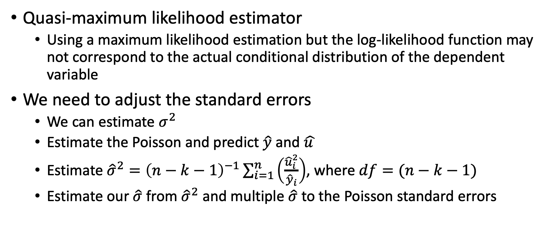
Overdispersion
Quasi-maximum likelihood estimator
Using a maximum likelihood estimation but the log-likelihood function may not correspond to the actual conditional distribution of the dependent variable
We need to adjust the standard errors
We can estimate $σ^{2}$
Estimate the Poisson and predict $\hat{y}$ and $\hat{u }$
Estimate ${\hat{σ}}^{2}={\left(n−k−1\right)}^{−1}\sum_{i=1}^{n}{\left(\frac{{\hat{u}}_{i}^{2}}{{\hat{y}}_{i}}\right)}$, where $df=(n−k−1)$
Estimate our $\hat{σ}$ from ${\hat{σ}}^{2}$ and multiple $\hat{σ}$ to the Poisson standard errors

Slide 17
Negative Binomial
Long and Freese (2014)

Slide 18
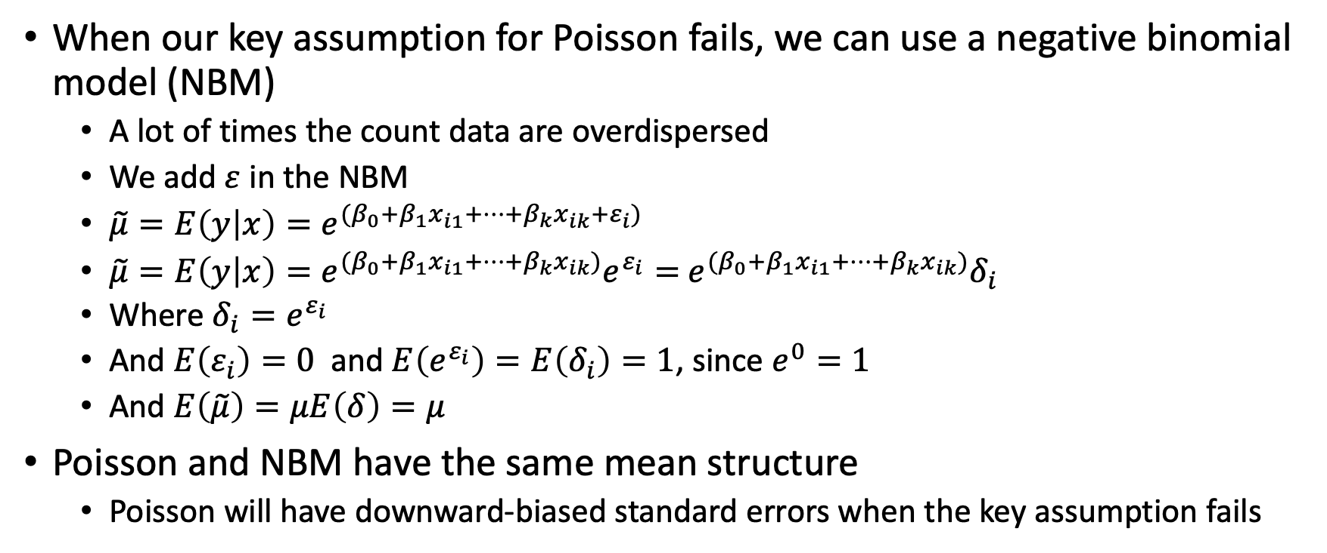
Negative Binomial Regression Model
When our key assumption for Poisson fails, we can use a negative binomial model (NBM)
A lot of times the count data are overdispersed
We add $ε$ in the NBM
$\tilde{μ}=E\left(y | x\right)=e^{{(β}_{0}+β_{1}x_{i1}+…+β_{k}x_{ik}+ε_{i})}$
$\tilde{μ}=E\left(y | x\right)=e^{{(β}_{0}+β_{1}x_{i1}+…+β_{k}x_{ik})}e^{ε_{i}}=$ $e^{{(β}_{0}+β_{1}x_{i1}+…+β_{k}x_{ik})}δ_{i}$
Where $δ_{i}=e^{ε_{i}}$
And $E\left(ε_{i}\right)=0$ and $E\left(e^{ε_{i}}\right)=E\left(δ_{i}\right)=1$, since $e^{0}=1$
And $E\left(\tilde{μ}\right)=μE\left(δ\right)=μ$
Poisson and NBM have the same mean structure
Poisson will have downward-biased standard errors when the key assumption fails

Slide 19
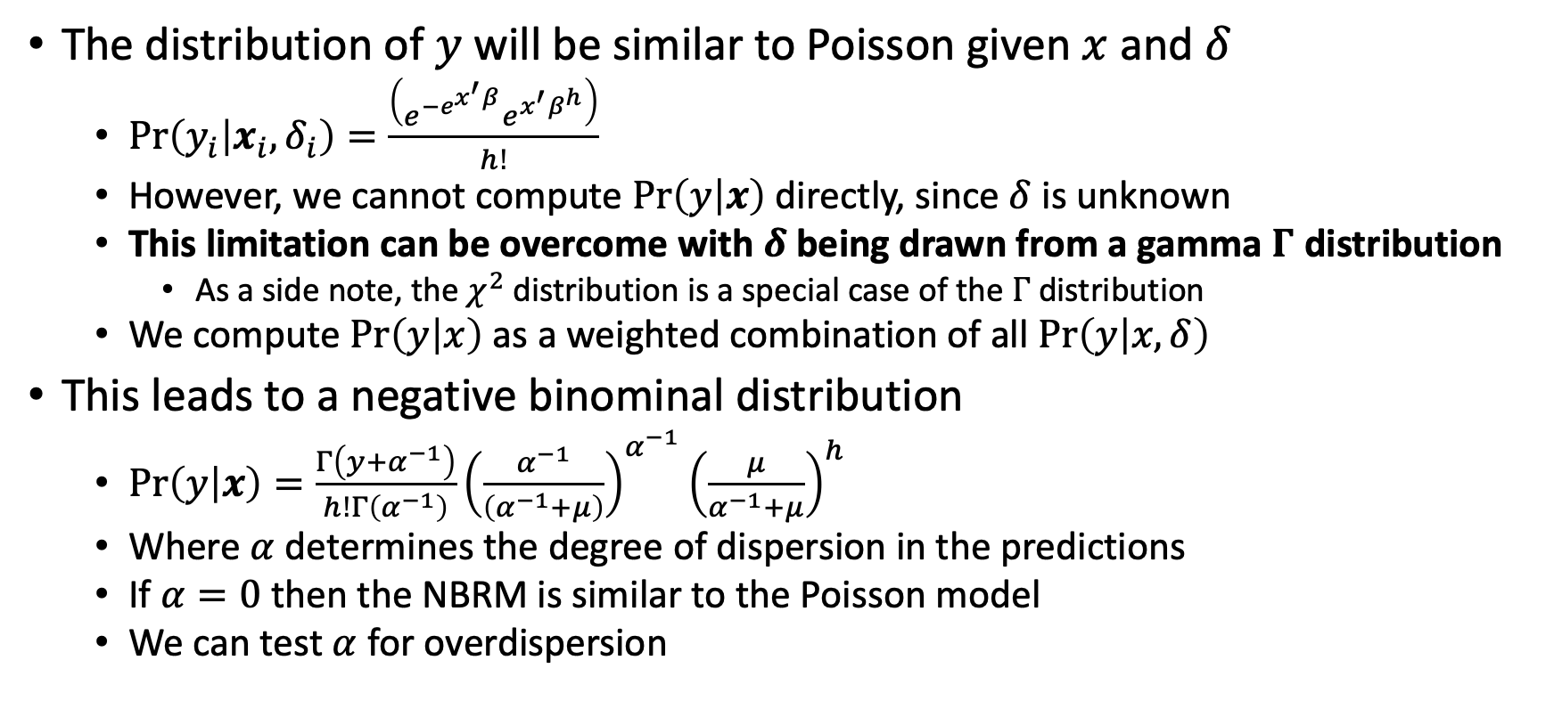
Negative Binomial Regression Model
The distribution of $y$will be similar to Poisson given $x$ and $δ$
$\operatorname{Pr}\left(y_{i} | x_{i},δ_{i}\right)=\frac{\left(e^{−e^{x^{′}β}}e^{x^{′}β^{h}}\right)}{h!}$
However, we cannot compute $\operatorname{Pr}\left(y | x\right)$ directly, since $δ$ is unknown
This limitation can be overcome with $δ$ being drawn from a gamma $Γ$ distribution
As a side note, the $χ^{2}$ distribution is a special case of the $Γ$ distribution
We compute $\operatorname{Pr}\left(y | x\right)$ as a weighted combination of all $\operatorname{Pr}\left(y | x,δ\right)$
This leads to a negative binominal distribution
$\operatorname{Pr}\left(y | x\right)=\frac{Γ\left(y+α^{−1}\right)}{h!Γ\left(α^{−1}\right)}{\left(\frac{α^{−1}}{\left(α^{−1}+μ\right)}\right)}^{α^{−1}}{\left(\frac{μ}{α^{−1}+μ}\right)}^{h}$
Where $α$determines the degree of dispersion in the predictions
If $α=0$ then the NBRM is similar to the Poisson model
We can test $α$ for overdispersion

Slide 20
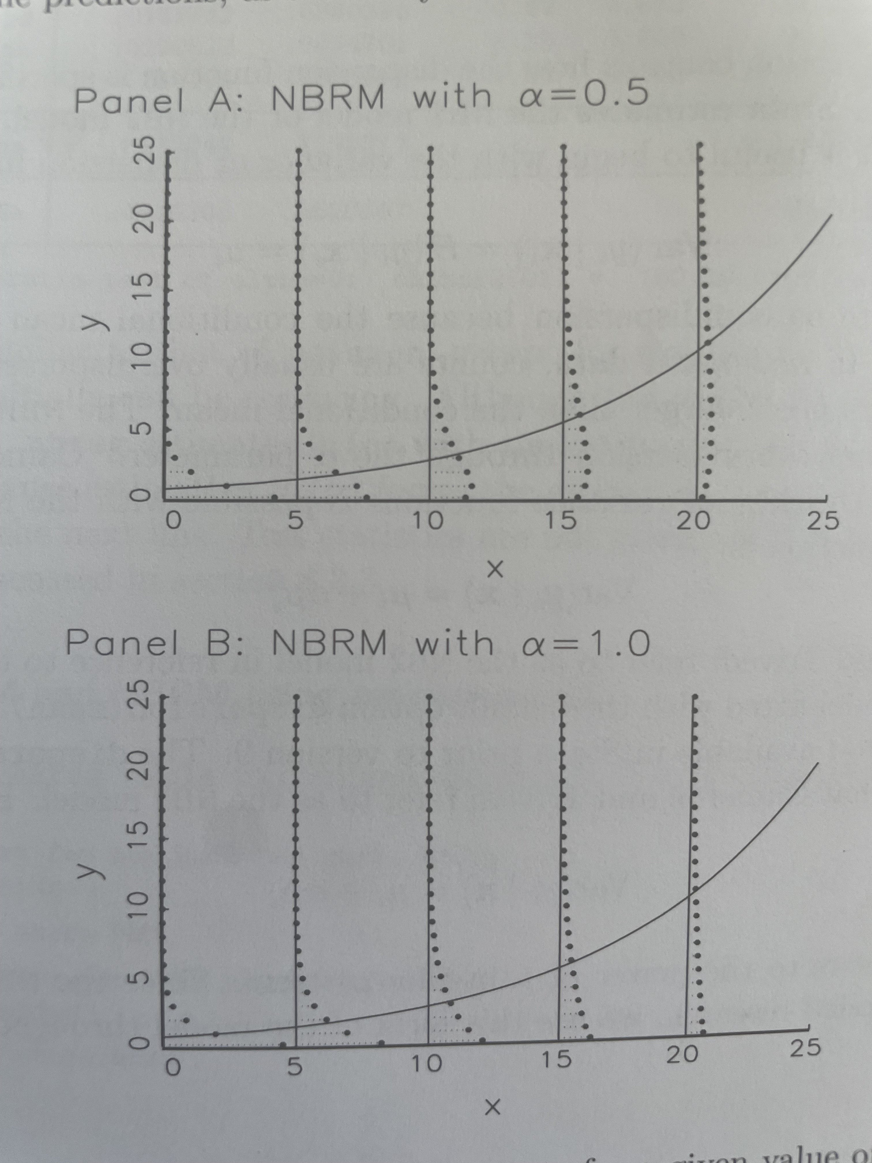
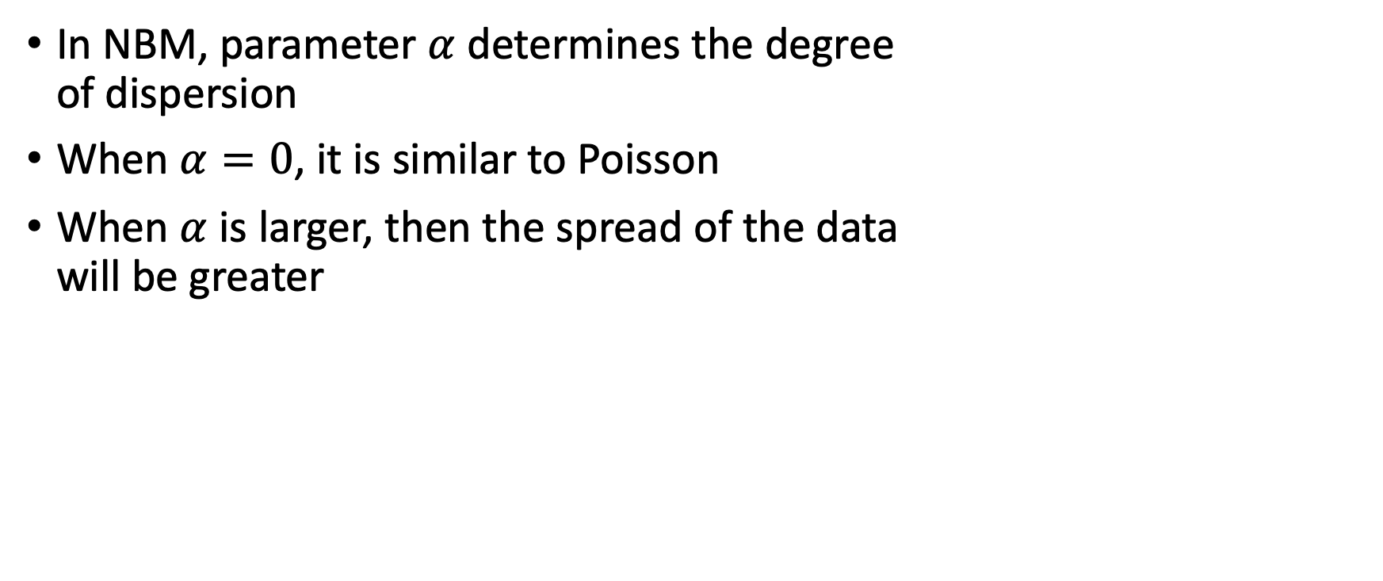
Negative Binomial Regression Model
In NBM, parameter $α$ determines the degree of dispersion
When $α=0$, it is similar to Poisson
When $α$ is larger, then the spread of the data will be greater

Slide 21
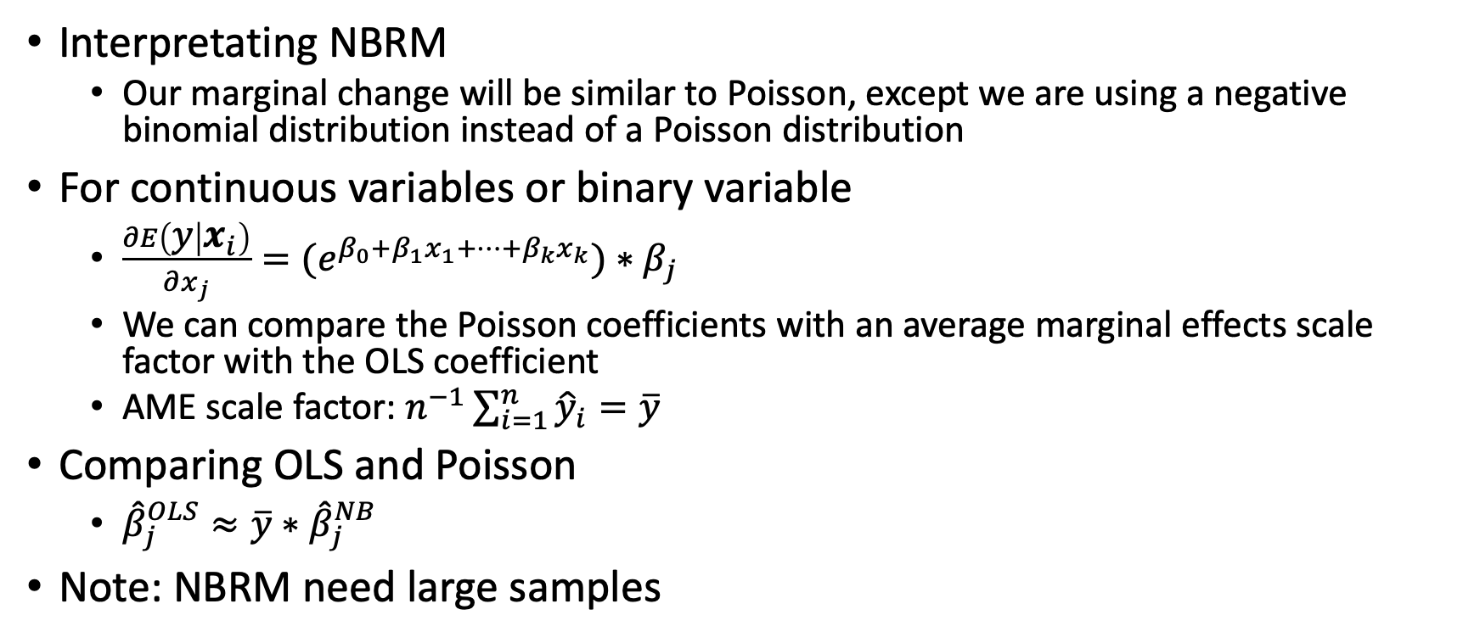
Interpreting NBRM
Interpretating NBRM
Our marginal change will be similar to Poisson, except we are using a negative binomial distribution instead of a Poisson distribution
For continuous variables or binary variable
$\frac{∂E\left(y | x_{i}\right)}{∂x_{j}}={(e}^{β_{0}+β_{1}x_{1}+…+β_{k}x_{k}})∗β_{j}$
We can compare the Poisson coefficients with an average marginal effects scale factor with the OLS coefficient
AME scale factor: $n^{−1}\sum_{i=1}^{n}{{\hat{y}}_{i}=\overline{y}}$
Comparing OLS and Poisson
${\hat{β}}_{j}^{OLS}≈\overline{y}∗{\hat{β}}_{j}^{NB}$
Note: NBRM need large samples

Slide 22
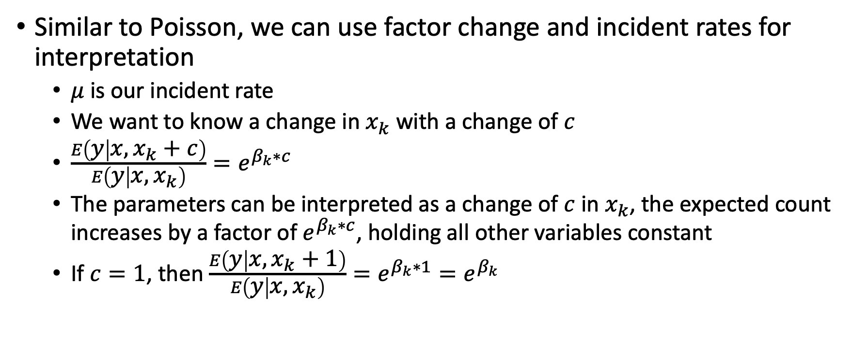
Interpreting NBRM
Similar to Poisson, we can use factor change and incident rates for interpretation
$μ$ is our incident rate
We want to know a change in $x_{k}$ with a change of $c$
$\frac{E\left(y | x,x_{k}+c\right)}{E\left(y | x,x_{k}\right)}=e^{β_{k}∗c}$
The parameters can be interpreted as a change of $c$ in $x_{k}$, the expected count increases by a factor of $e^{β_{k}∗c}$, holding all other variables constant
If $c=1$, then $\frac{E\left(y | x,x_{k}+1\right)}{E\left(y | x,x_{k}\right)}=e^{β_{k}∗1}=e^{β_{k}}$

Slide 23
Censored and Truncated Models
Wooldridge

Slide 24
Censored and Truncated Models
Censoring
Censoring is usually due to some survey design and it’s different from a corner solution
Example: wages in the Current Population Survey are censored or top coded at $2,885.00 per week
We know that weekly wages go beyond $2,885.00 but they are top coded (or censured)
Censored Regression Model
A regression model where the dependent variable has been censored above or below some known threshold
This regression model solves a missing data problem on the response variable

Slide 25
Censored and Truncated Models
Data Truncating
Truncation occurs when a subset of the population is excluded from the sampling scheme
We restrict attention to a subset of the population
There is part of the population where we have no data
Example: The Current Population excludes members of the Armed Forces, since it focuses on the non-institutional civilian population
Truncated Regression Model
A linear regression model for cross-sectional data in which the sampling scheme entirely excludes part of the population on the basis of outcomes on the dependent variable

Slide 26
Censored and Truncated Models
Censored data
The data exist for the population, but it is top-coded or bottom-coded
The data exist but are censored for various reasons
For example, wages is top-coded at $2,885 in the CPS
For example, the rate of opioid deaths per capita per capita is bottom-coded to prevent disclosure or to prevent identification of the population
Truncated data
The data exist for only a portion of the population and a subset of the population is excluded
For example, in the CPS, the military population is excluded even though they are workers earnings a pay check
Both are data collection issues unlike the corner solution

Slide 27
Censured Regression Models

Slide 28
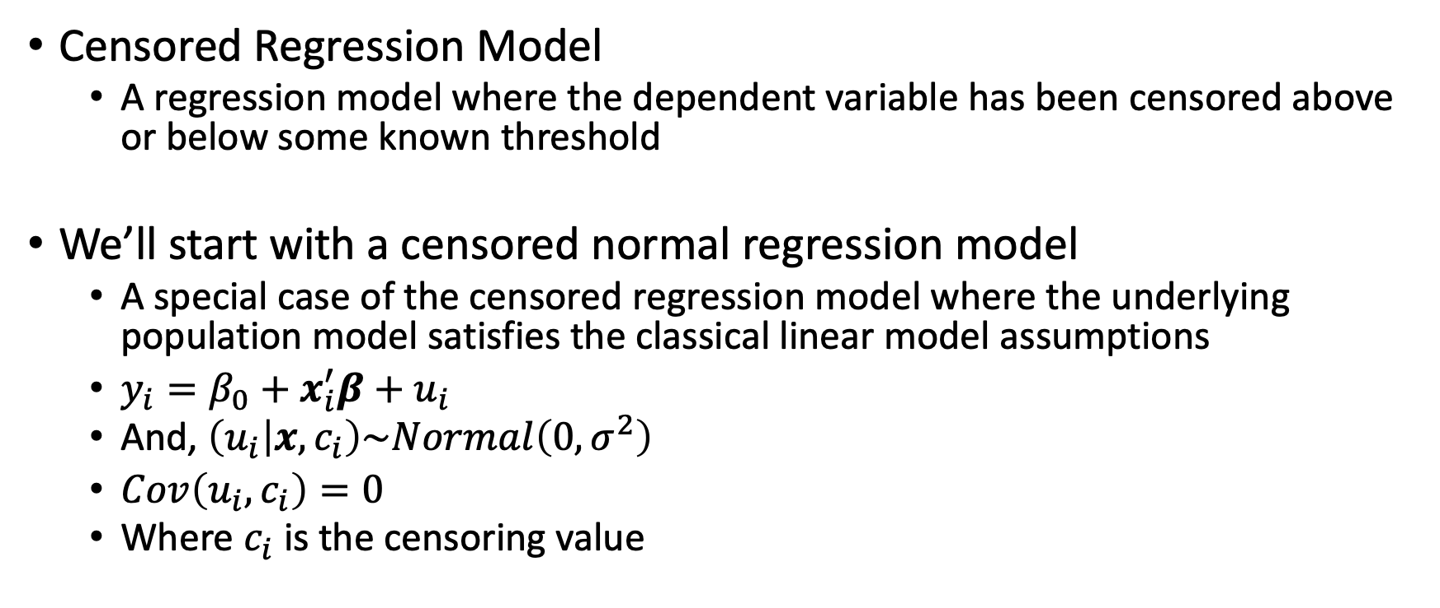
Censored Regression Model
Censored Regression Model
A regression model where the dependent variable has been censored above or below some known threshold
We’ll start with a censored normal regression model
A special case of the censored regression model where the underlying population model satisfies the classical linear model assumptions
$y_{i}=β_{0}+x_{i}^{′}β+u_{i}$
And, $\left(u_{i} | x,c_{i}\right)\sim Normal\left(0,σ^{2}\right)$
$Cov\left(u_{i},c_{i}\right)=0$
Where $c_{i}$ is the censoring value

Slide 29
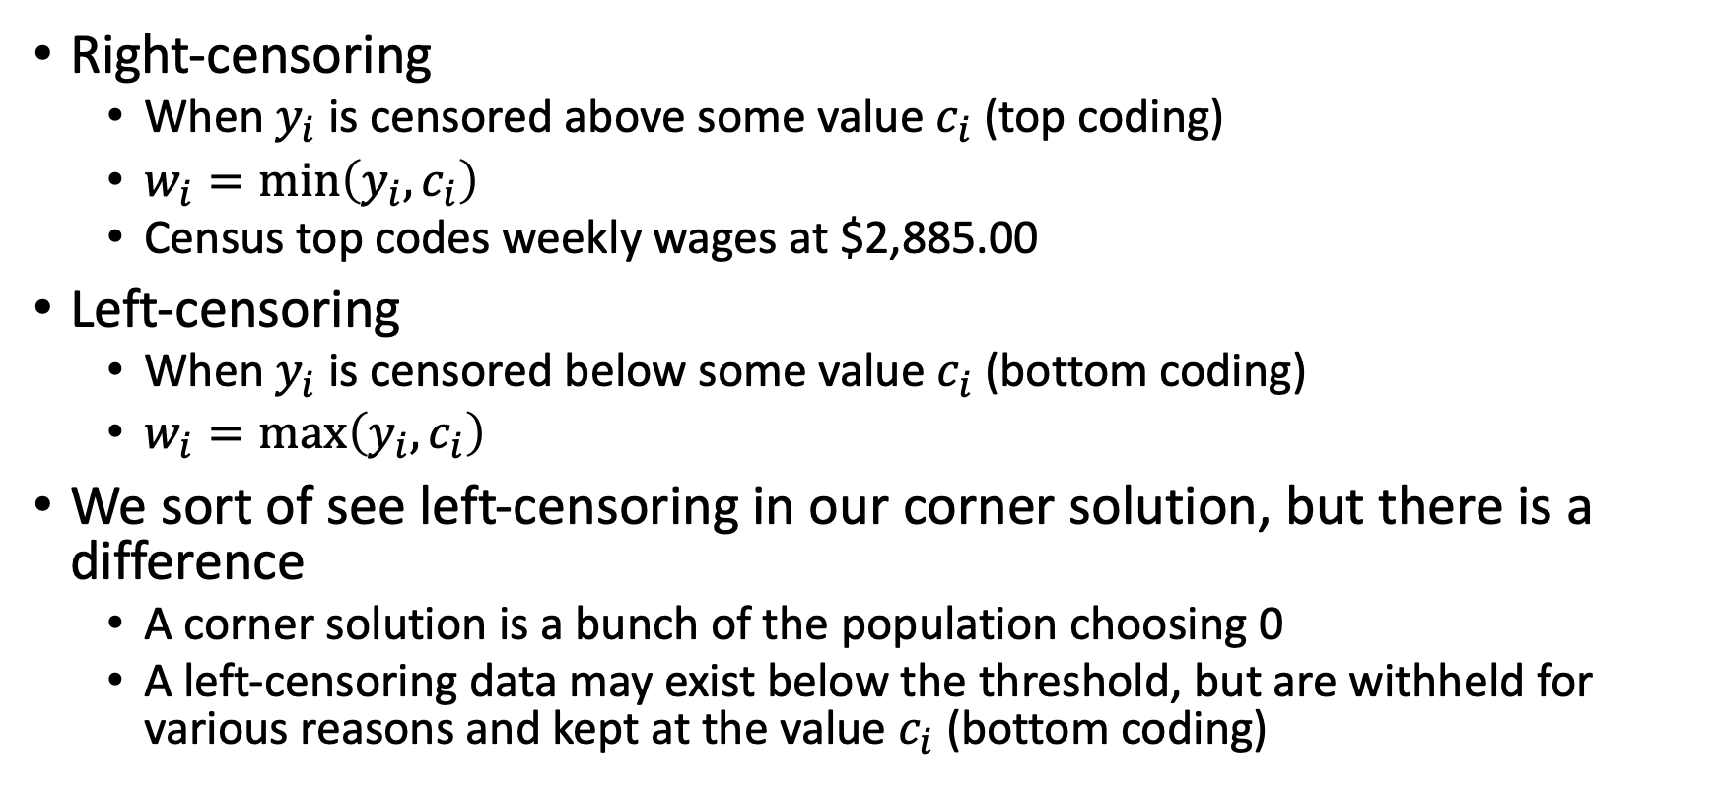
Censored Regression Model
Right-censoring
When $y_{i}$ is censored above some value $c_{i}$ (top coding)
$w_{i}=\min\left(y_{i},c_{i}\right)$
Census top codes weekly wages at $2,885.00
Left-censoring
When $y_{i}$ is censored below some value $c_{i}$ (bottom coding)
$w_{i}=\max\left(y_{i},c_{i}\right)$
We sort of see left-censoring in our corner solution, but there is a difference
A corner solution is a bunch of the population choosing 0
A left-censoring data may exist below the threshold, but are withheld for various reasons and kept at the value $c_{i}$ (bottom coding)

Slide 30
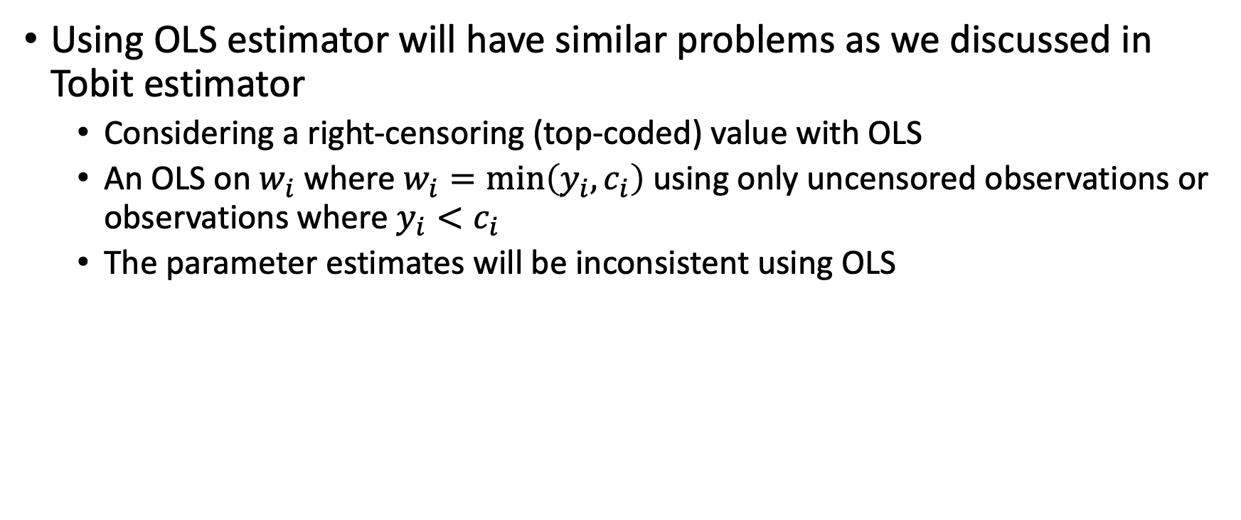
Censored Regression Model
Using OLS estimator will have similar problems as we discussed in Tobit estimator
Considering a right-censoring (top-coded) value with OLS
An OLS on $w_{i}$ where $w_{i}=\min\left(y_{i},c_{i}\right)$ using only uncensored observations or observations where $y_{i}<c_{i}$
The parameter estimates will be inconsistent using OLS

Slide 31
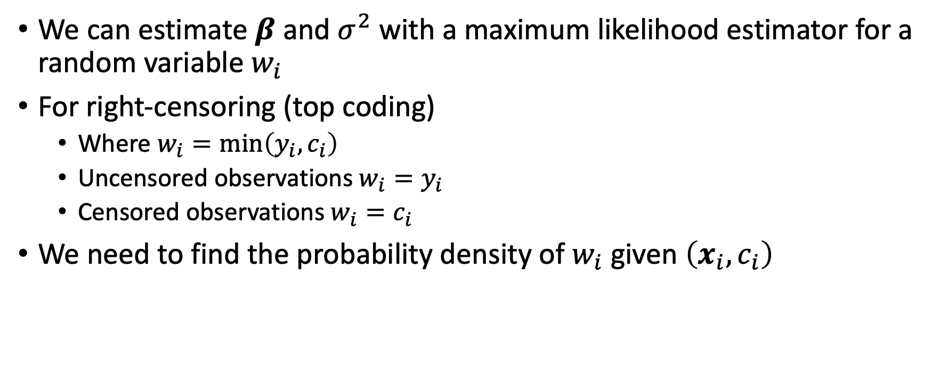
Censored Regression Model
We can estimate $β$ and $σ^{2}$ with a maximum likelihood estimator for a random variable $w_{i}$
For right-censoring (top coding)
Where $w_{i}=\min\left(y_{i},c_{i}\right)$
Uncensored observations $w_{i}=y_{i}$
Censored observations $w_{i}=c_{i}$
We need to find the probability density of $w_{i}$ given $\left(x_{i},c_{i}\right)$

Slide 32
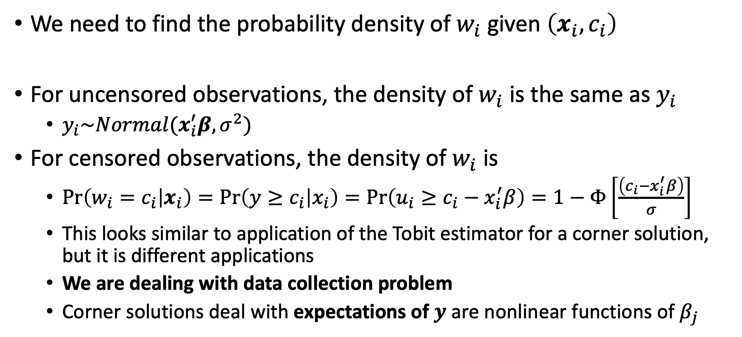
Censored Regression Model
We need to find the probability density of $w_{i}$ given $\left(x_{i},c_{i}\right)$
For uncensored observations, the density of $w_{i}$ is the same as $y_{i}$
$y_{i}\sim Normal(x_{i}^{′}β,σ^{2})$
For censored observations, the density of $w_{i}$ is
$\operatorname{Pr}\left(w_{i}=c_{i} | x_{i}\right)=\operatorname{Pr}\left(y≥c_{i} | x_{i}\right)=\operatorname{Pr}\left(u_{i}≥c_{i}−x_{i}^{′}β\right)=1−Φ\left[\frac{\left(c_{i}−x_{i}^{′}β\right)}{σ}\right]$
This looks similar to application of the Tobit estimator for a corner solution, but it is different applications
We are dealing with data collection problem
Corner solutions deal with expectations of $y$ are nonlinear functions of $β_{j}$

Slide 33
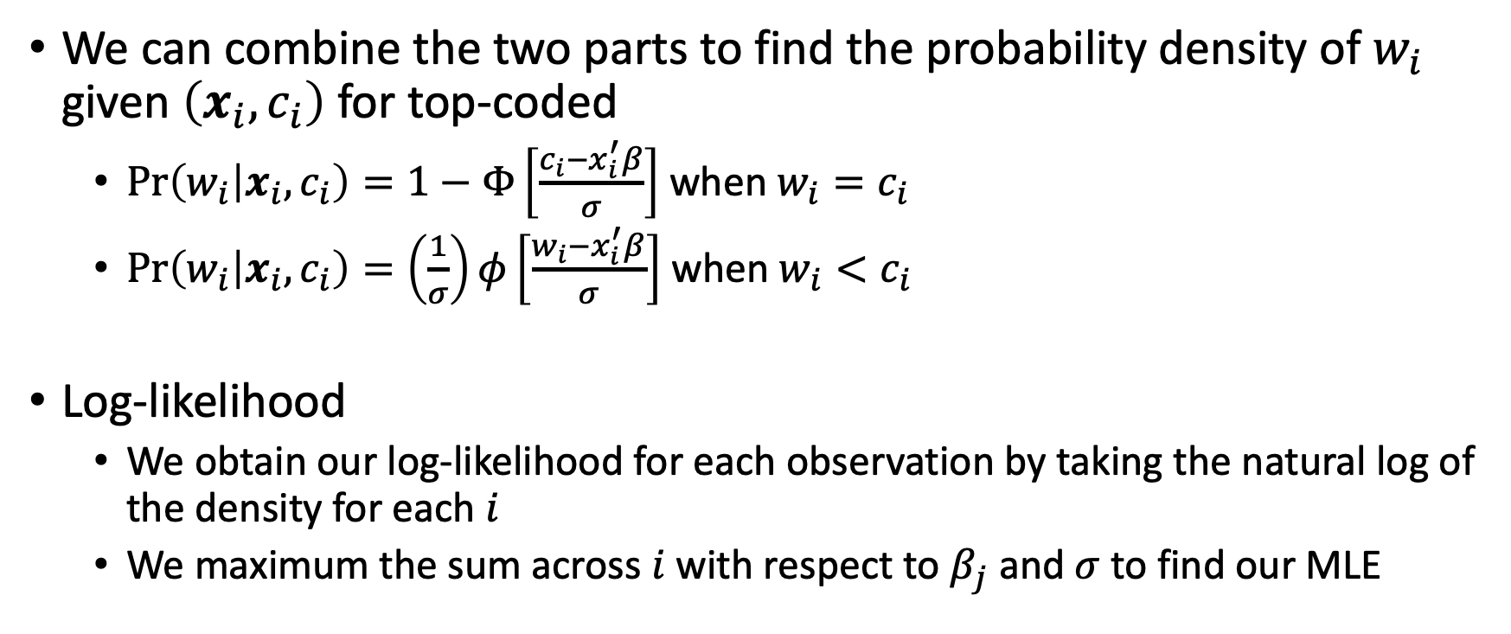
Censored Regression Model
We can combine the two parts to find the probability density of $w_{i}$ given $\left(x_{i},c_{i}\right)$ for top-coded
$\operatorname{Pr}\left(w_{i} | x_{i},c_{i}\right)=1−Φ\left[\frac{c_{i}−x_{i}^{′}β}{σ}\right]$ when $w_{i}=c_{i}$
$\operatorname{Pr}\left(w_{i} | x_{i},c_{i}\right)=\left(\frac{1}{σ}\right)φ\left[\frac{w_{i}−x_{i}^{′}β}{σ}\right]$ when $w_{i}<c_{i}$
Log-likelihood
We obtain our log-likelihood for each observation by taking the natural log of the density for each $i$
We maximum the sum across $i$with respect to $β_{j}$ and $σ$ to find our MLE

Slide 34
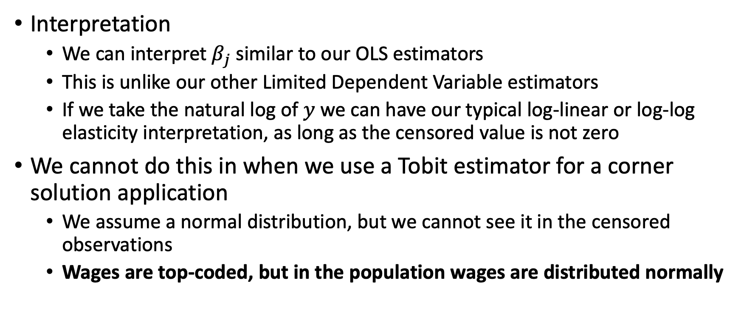
Censored Regression Model
Interpretation
We can interpret $β_{j}$ similar to our OLS estimators
This is unlike our other Limited Dependent Variable estimators
If we take the natural log of $y$ we can have our typical log-linear or log-log elasticity interpretation, as long as the censored value is not zero
We cannot do this in when we use a Tobit estimator for a corner solution application
We assume a normal distribution, but we cannot see it in the censored observations
Wages are top-coded, but in the population wages are distributed normally

Slide 35
Censored Regression Model
Along with top-coding, an application of censored regression model is duration analysis
Duration is a variable that measures the time before a certain event occurs
Examples
The time before an unemployed person becomes employed
The time before a released felon recidivates
We need a censored model for duration analysis
We may observations experience the event or it may take so long that we need to censor the data in order to analyze it
We’ll cover a duration example in Stata

Slide 36
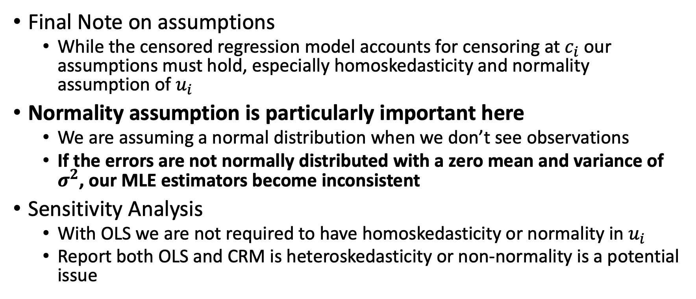
Censored Regression Model
Final Note on assumptions
While the censored regression model accounts for censoring at $c_{i}$ our assumptions must hold, especially homoskedasticity and normality assumption of $u_{i}$
Normality assumption is particularly important here
We are assuming a normal distribution when we don’t see observations
If the errors are not normally distributed with a zero mean and variance of $σ^{2}$, our MLE estimators become inconsistent
Sensitivity Analysis
With OLS we are not required to have homoskedasticity or normality in $u_{i}$
Report both OLS and CRM is heteroskedasticity or non-normality is a potential issue

Slide 37
Truncated Regression Models

Slide 38
Truncated Regression Models
Data Truncating
Truncation occurs when a subset of the population is excluded from the sampling scheme
We restrict attention to a subset of the population
There is part of the population where we have no data
Truncated Regression Model
A linear regression model for cross-sectional data in which the sampling scheme entirely excludes part of the population on the basis of outcomes on the dependent variable

Slide 39
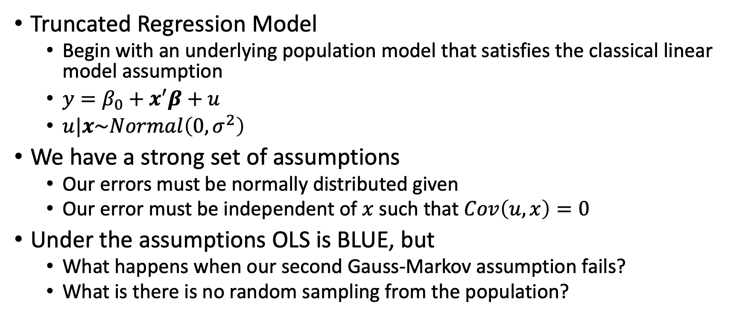
Truncated Regression Models
Truncated Regression Model
Begin with an underlying population model that satisfies the classical linear model assumption
$y=β_{0}+x^{′}β+u$
$u|x\sim Normal\left(0,σ^{2}\right)$
We have a strong set of assumptions
Our errors must be normally distributed given
Our error must be independent of $x$ such that $Cov\left(u,x\right)=0$
Under the assumptions OLS is BLUE, but
What happens when our second Gauss-Markov assumption fails?
What is there is no random sampling from the population?

Slide 40
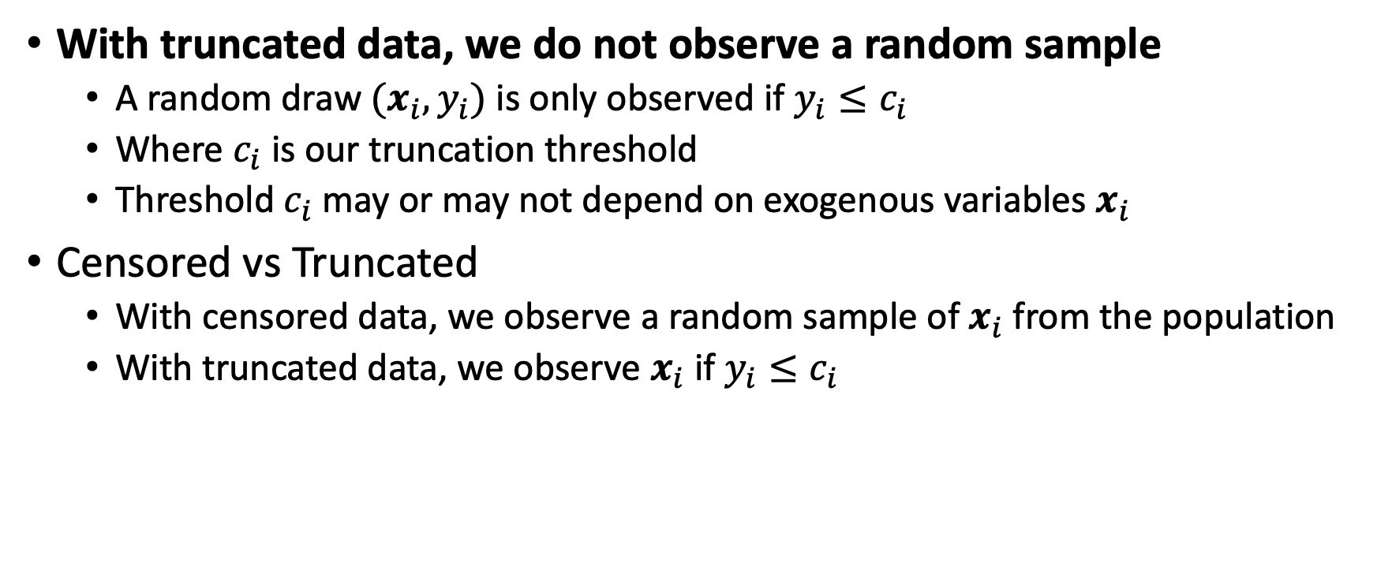
Truncated Regression Models
With truncated data, we do not observe a random sample
A random draw $(x_{i},y_{i})$ is only observed if $y_{i}≤c_{i}$
Where $c_{i}$ is our truncation threshold
Threshold $c_{i}$ may or may not depend on exogenous variables $x_{i}$
Censored vs Truncated
With censored data, we observe a random sample of $x_{i}$ from the population
With truncated data, we observe $x_{i}$ if $y_{i}≤c_{i}$

Slide 41
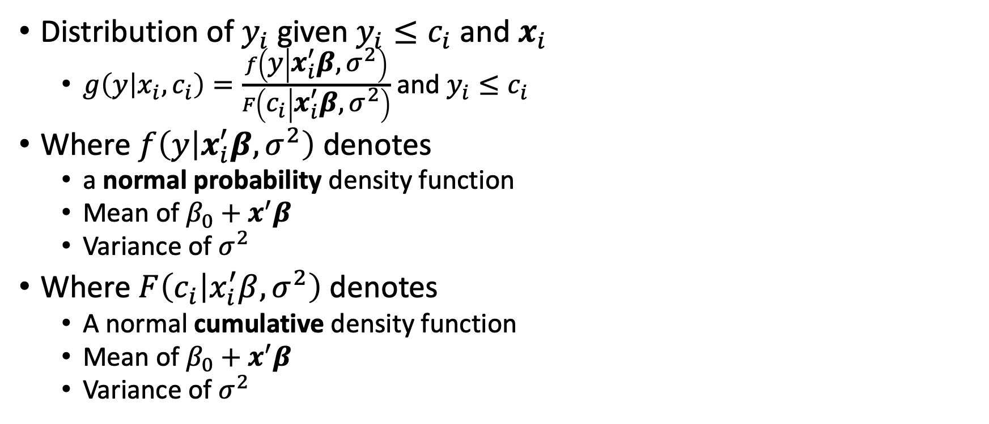
Truncated Regression Models
Distribution of $y_{i}$ given $y_{i}≤c_{i}$ and $x_{i}$
$g\left(y | x_{i},c_{i}\right)=\frac{f\left(y | x_{i}^{′}β,σ^{2}\right)}{F\left(c_{i} | x_{i}^{′}β,σ^{2}\right)}$ and $y_{i}≤c_{i}$
Where $f\left(y | x_{i}^{′}β,σ^{2}\right)$ denotes
a normal probability density function
Mean of $β_{0}+x^{′}β$
Variance of $σ^{2}$
Where $F\left(c_{i} | x_{i}^{′}β,σ^{2}\right)$ denotes
A normal cumulative density function
Mean of $β_{0}+x^{′}β$
Variance of $σ^{2}$

Slide 42
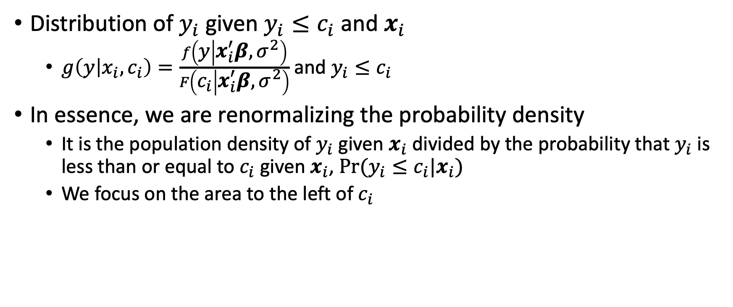
Truncated Regression Models
Distribution of $y_{i}$ given $y_{i}≤c_{i}$ and $x_{i}$
$g\left(y | x_{i},c_{i}\right)=\frac{f\left(y | x_{i}^{′}β,σ^{2}\right)}{F\left(c_{i} | x_{i}^{′}β,σ^{2}\right)}$ and $y_{i}≤c_{i}$
In essence, we are renormalizing the probability density
It is the population density of $y_{i}$ given $x_{i}$ divided by the probability that $y_{i}$ is less than or equal to $c_{i}$ given $x_{i}$, $Pr⁡(y_{i}≤c_{i}|x_{i})$
We focus on the area to the left of $c_{i}$

Slide 43
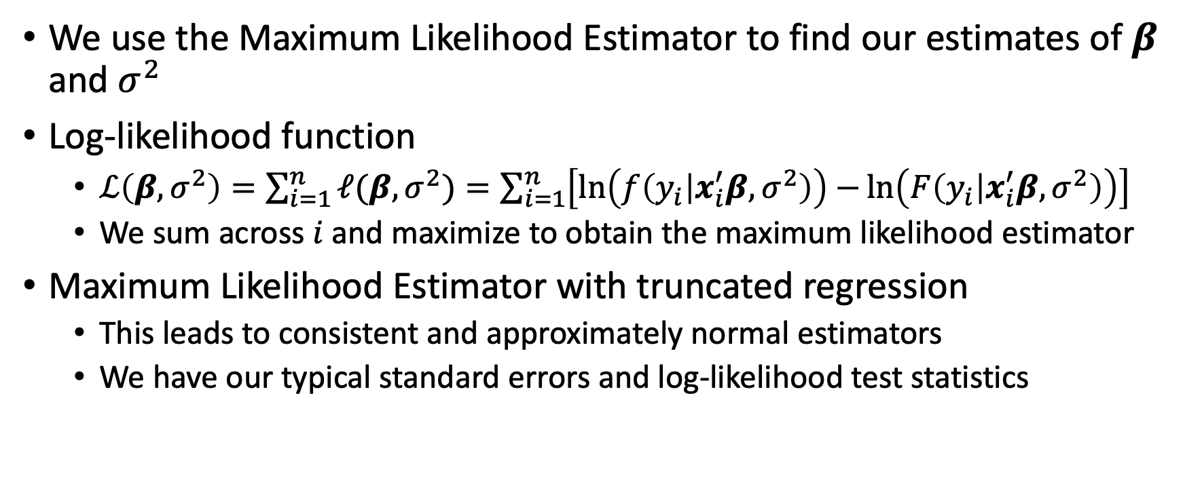
Truncated Regression Models
We use the Maximum Likelihood Estimator to find our estimates of $β$ and $σ^{2}$
Log-likelihood function
$ℒ\left(β,σ^{2}\right)=\sum_{i=1}^{n}{ℓ(β, σ^{2})}=\sum_{i=1}^{n}{\left[\ln\left(f\left(y_{i} | x_{i}^{′}β,σ^{2}\right)\right)−\ln\left(F\left(y_{i} | x_{i}^{′}β,σ^{2}\right)\right)\right] }$
We sum across $i$and maximize to obtain the maximum likelihood estimator
Maximum Likelihood Estimator with truncated regression
This leads to consistent and approximately normal estimators
We have our typical standard errors and log-likelihood test statistics

Slide 44
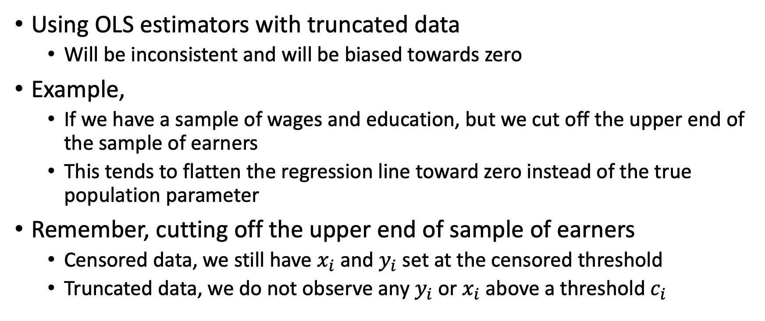
Truncated Regression Models
Using OLS estimators with truncated data
Will be inconsistent and will be biased towards zero
Example,
If we have a sample of wages and education, but we cut off the upper end of the sample of earners
This tends to flatten the regression line toward zero instead of the true population parameter
Remember, cutting off the upper end of sample of earners
Censored data, we still have $x_{i}$ and $y_{i}$ set at the censored threshold
Truncated data, we do not observe any $y_{i}$ or $x_{i}$ above a threshold $c_{i}$

Slide 45
Truncated Regression Models
Final note on assumptions for truncated regression models
As with censored data, if the data are not homoskedastic and/or distributed normally, then the MLE will be biased and inconsistent
Sensitivity Analysis
Report both OLS and truncated regression model estimates
Discuss truncated threshold, heteroskedasticity, and normality

Slide 46
Sample Selection

Slide 47
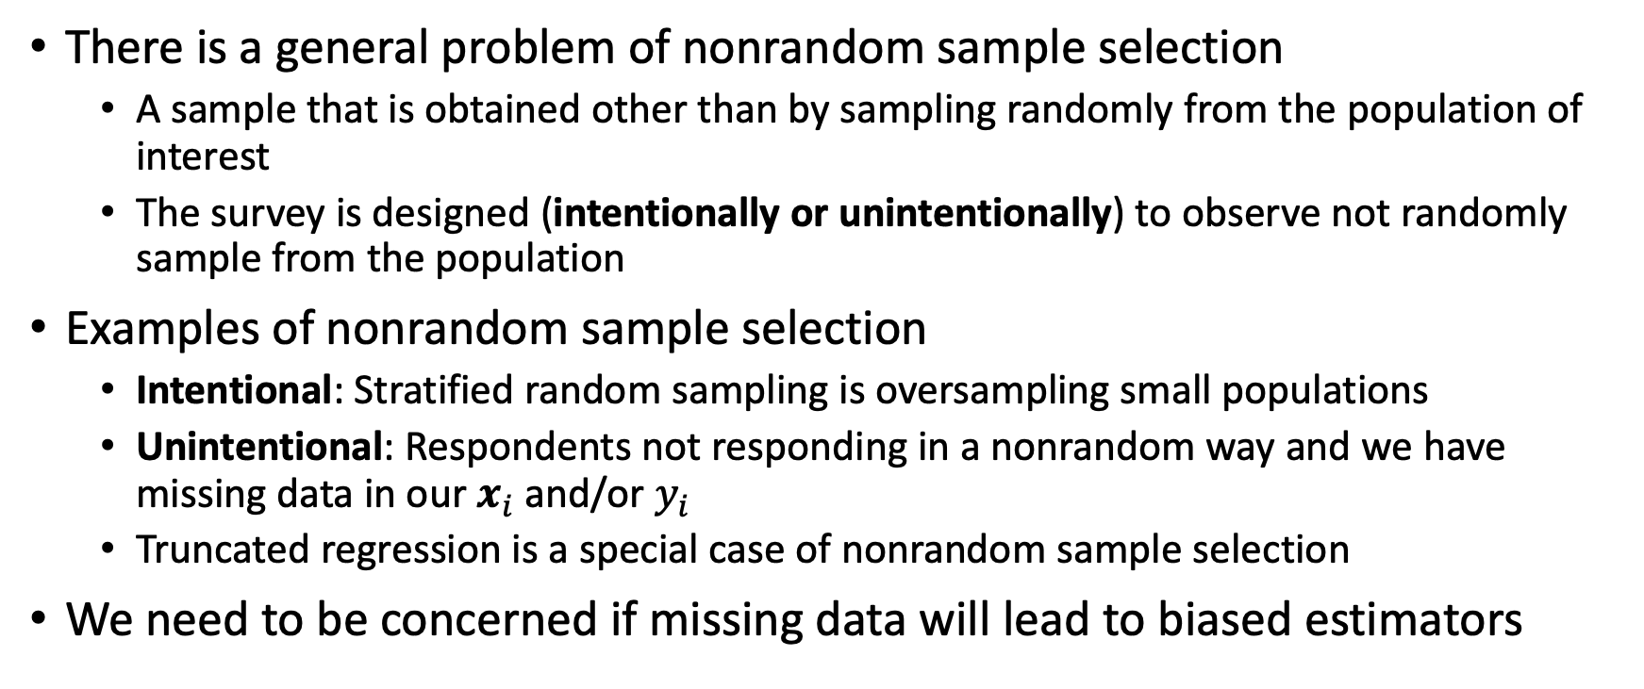
Sample Selection Correction
There is a general problem of nonrandom sample selection
A sample that is obtained other than by sampling randomly from the population of interest
The survey is designed (intentionally or unintentionally) to observe not randomly sample from the population
Examples of nonrandom sample selection
Intentional: Stratified random sampling is oversampling small populations
Unintentional: Respondents not responding in a nonrandom way and we have missing data in our $x_{i}$ and/or $y_{i}$
Truncated regression is a special case of nonrandom sample selection
We need to be concerned if missing data will lead to biased estimators

Slide 48
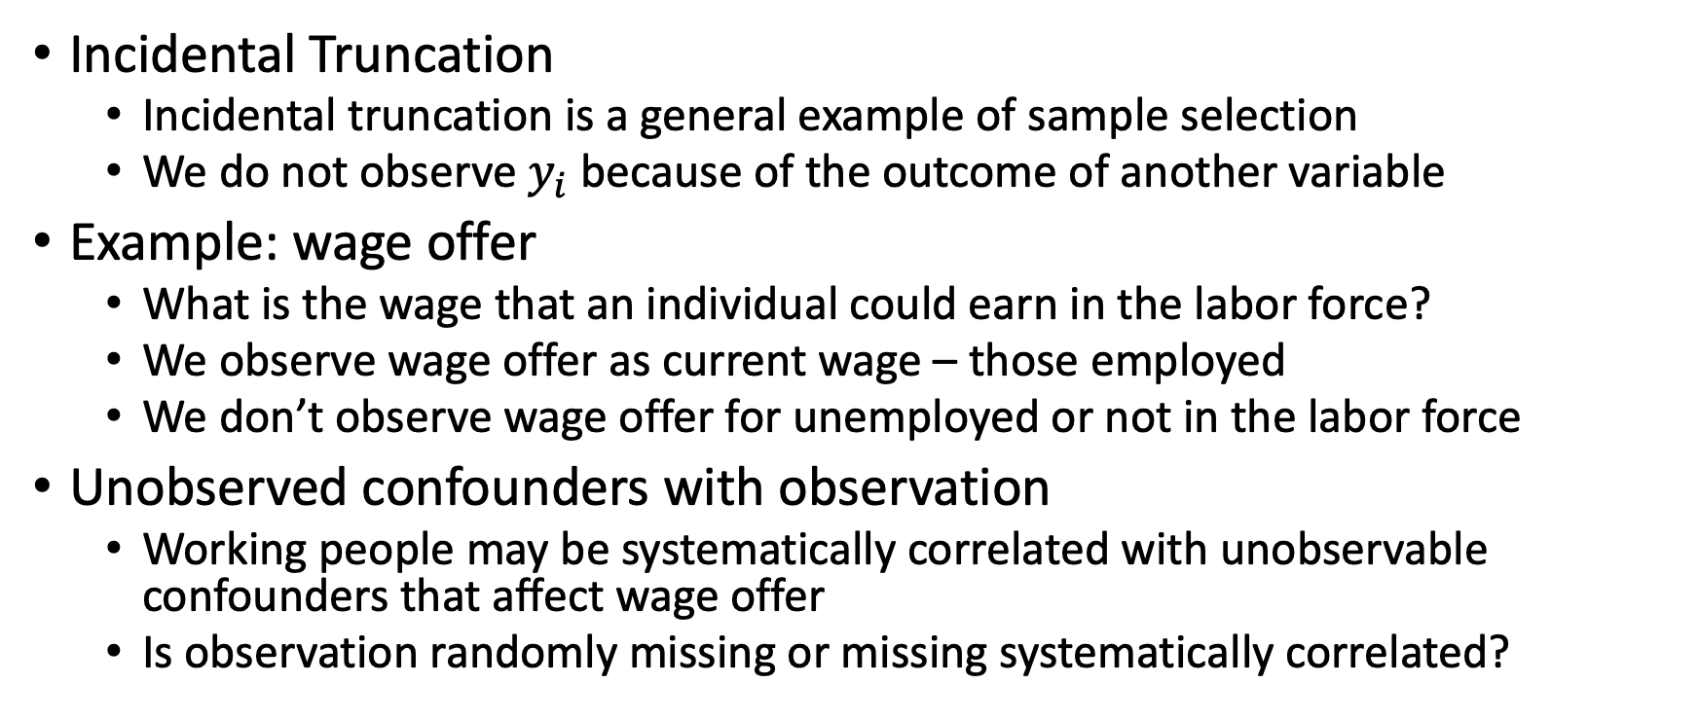
Sample Selection Correction
Incidental Truncation
Incidental truncation is a general example of sample selection
We do not observe $y_{i}$ because of the outcome of another variable
Example: wage offer
What is the wage that an individual could earn in the labor force?
We observe wage offer as current wage – those employed
We don’t observe wage offer for unemployed or not in the labor force
Unobserved confounders with observation
Working people may be systematically correlated with unobservable confounders that affect wage offer
Is observation randomly missing or missing systematically correlated?

Slide 49
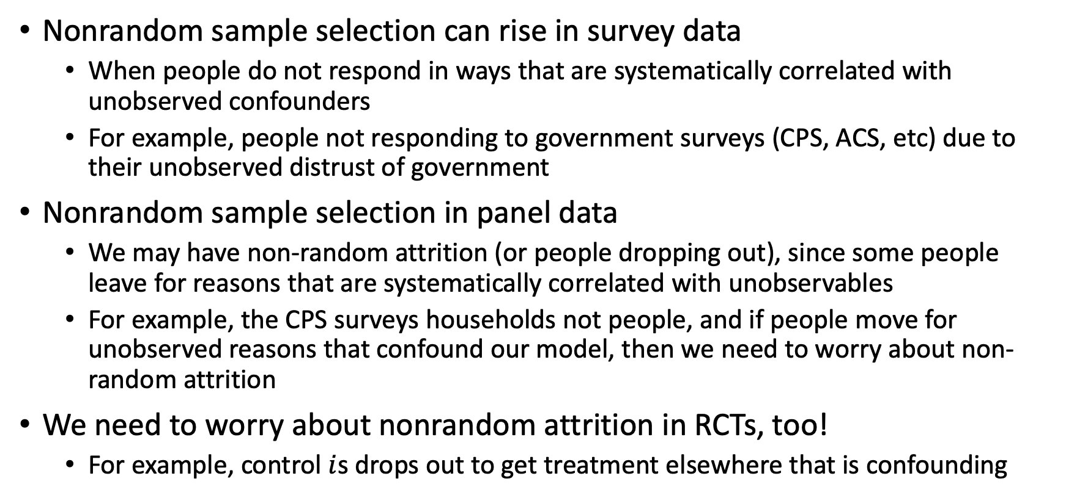
Sample Selection Correction
Nonrandom sample selection can rise in survey data
When people do not respond in ways that are systematically correlated with unobserved confounders
For example, people not responding to government surveys (CPS, ACS, etc) due to their unobserved distrust of government
Nonrandom sample selection in panel data
We may have non-random attrition (or people dropping out), since some people leave for reasons that are systematically correlated with unobservables
For example, the CPS surveys households not people, and if people move for unobserved reasons that confound our model, then we need to worry about non-random attrition
We need to worry about nonrandom attrition in RCTs, too!
For example, control $i$s drops out to get treatment elsewhere that is confounding

Slide 50
Sample Selection Correction
First Question
Is OLS consistent with the sample selection?
We have two types of sample selection
Endogenous sample selection – OLS is inconsistent
Exogenous sample selection – OLS can be consistent
Examples
In a truncated case, we have endogenous sample selection
If we have a sample determined solely by an exogenous variable, then we have exogenous sample selection, think stratified sample – we oversample
Many times, we’ll have cases between these two extreme ends

Slide 51
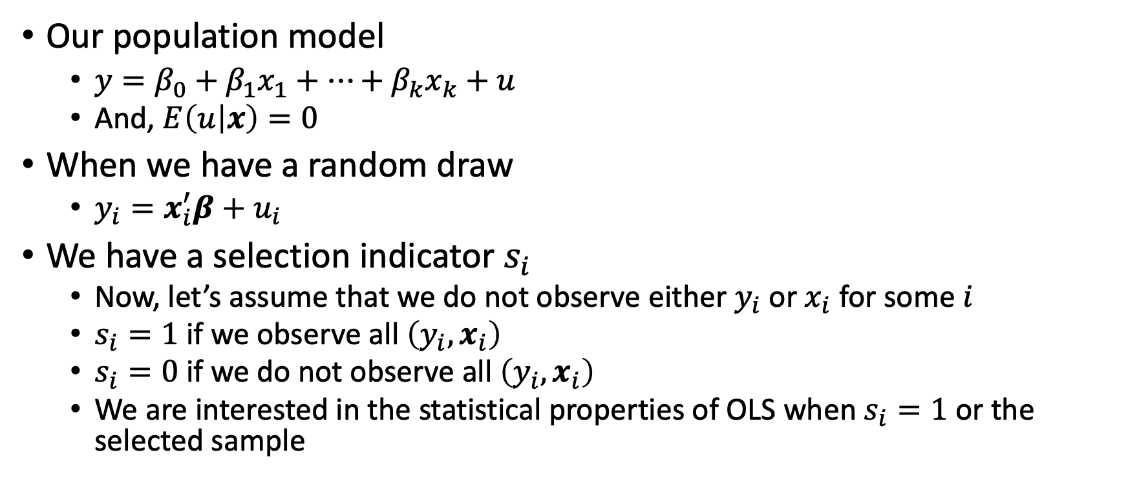
Sample Selection Correction
Our population model
$y=β_{0}+β_{1}x_{1}+…+β_{k}x_{k}+u$
And, $E\left(u | x\right)=0$
When we have a random draw
$y_{i}=x_{i}^{′}β+u_{i}$
We have a selection indicator $s_{i}$
Now, let’s assume that we do not observe either $y_{i}$ or $x_{i}$ for some $i$
$s_{i}=1$ if we observe all $\left(y_{i},x_{i}\right)$
$s_{i}=0$ if we do not observe all $\left(y_{i},x_{i}\right)$
We are interested in the statistical properties of OLS when $s_{i}=1$ or the selected sample

Slide 52
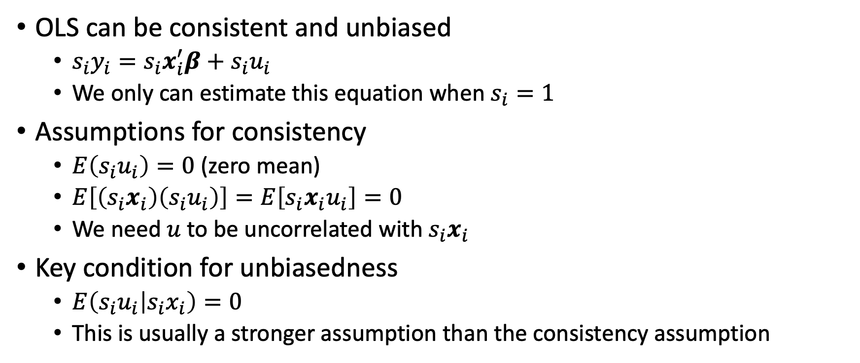
Sample Selection Correction
OLS can be consistent and unbiased
$s_{i}y_{i}=s_{i}x_{i}^{′}β+s_{i}u_{i}$
We only can estimate this equation when $s_{i}=1$
Assumptions for consistency
$E\left(s_{i}u_{i}\right)=0$ (zero mean)
$E\left[\left(s_{i}x_{i}\right)\left(s_{i}u_{i}\right)\right]=E\left[s_{i}x_{i}u_{i}\right]=0$
We need $u$to be uncorrelated with $s_{i}x_{i}$
Key condition for unbiasedness
$E\left(s_{i}u_{i} | s_{i}x_{i}\right)=0$
This is usually a stronger assumption than the consistency assumption

Slide 53
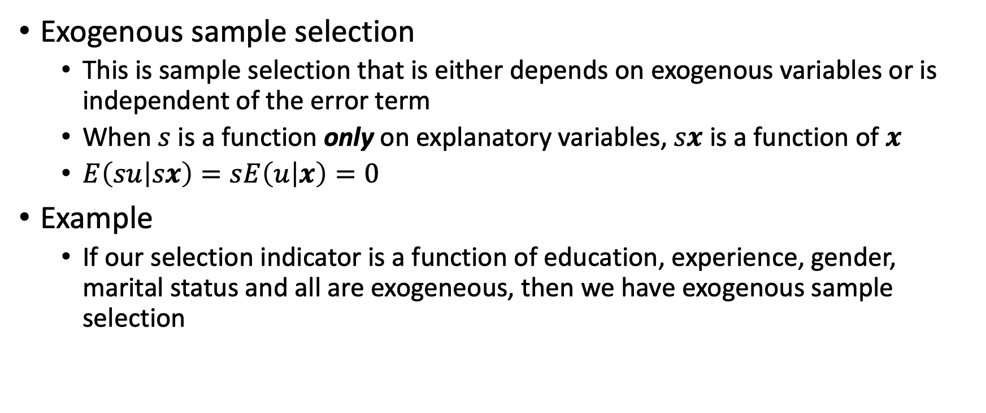
Sample Selection Correction
Exogenous sample selection
This is sample selection that is either depends on exogenous variables or is independent of the error term
When $s$ is a function only on explanatory variables, $sx$ is a function of $x$
$E\left(su | sx\right)=sE\left(u | x\right)=0$
Example
If our selection indicator is a function of education, experience, gender, marital status and all are exogeneous, then we have exogenous sample selection

Slide 54
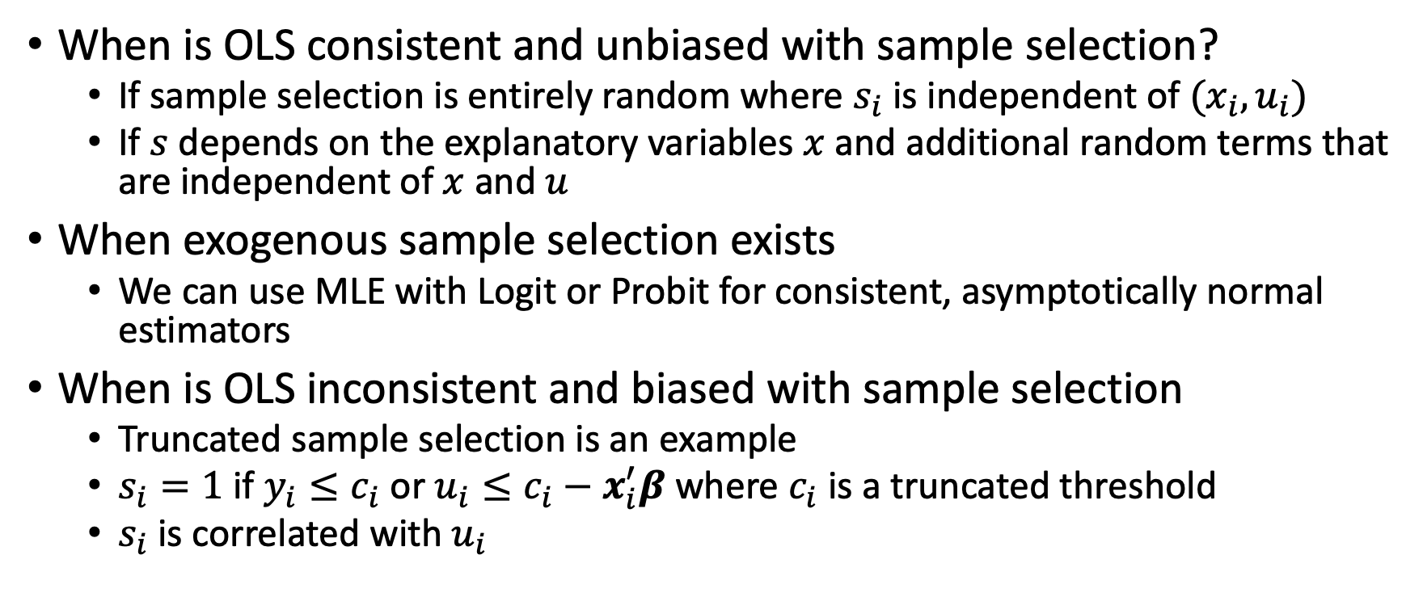
Sample Selection Correction
When is OLS consistent and unbiased with sample selection?
If sample selection is entirely random where $s_{i}$ is independent of $(x_{i},u_{i})$
If $s$ depends on the explanatory variables $x$ and additional random terms that are independent of $x$ and $u$
When exogenous sample selection exists
We can use MLE with Logit or Probit for consistent, asymptotically normal estimators
When is OLS inconsistent and biased with sample selection
Truncated sample selection is an example
$s_{i}=1$ if $y_{i}≤c_{i}$ or $u_{i}≤c_{i}−x_{i}^{′}β$ where $c_{i}$ is a truncated threshold
$s_{i}$ is correlated with $u_{i}$

Slide 55
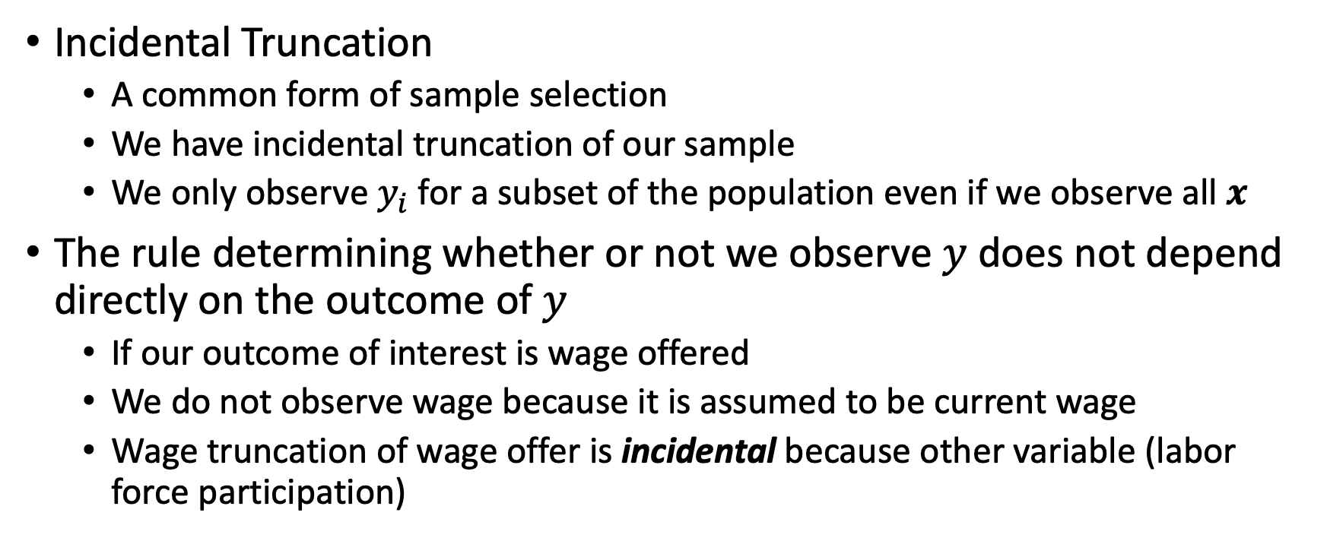
Incidental Truncation
Incidental Truncation
A common form of sample selection
We have incidental truncation of our sample
We only observe $y_{i}$ for a subset of the population even if we observe all $x$
The rule determining whether or not we observe $y$ does not depend directly on the outcome of $y$
If our outcome of interest is wage offered
We do not observe wage because it is assumed to be current wage
Wage truncation of wage offer is incidental because other variable (labor force participation)

Slide 56
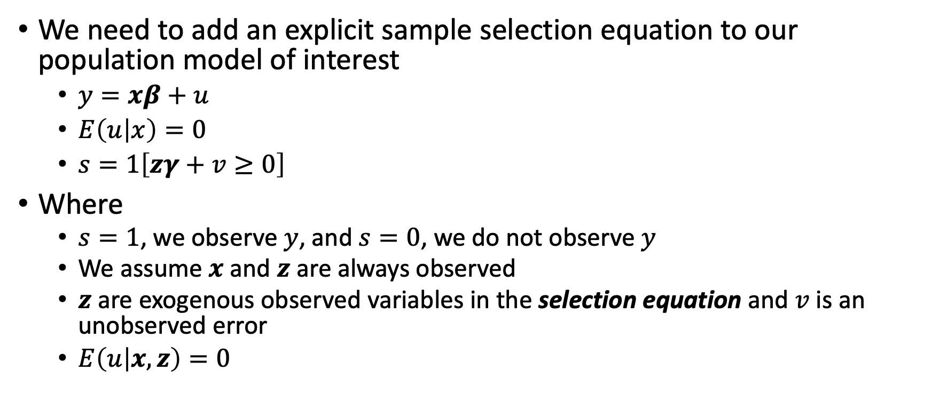
Incidental Truncation
We need to add an explicit sample selection equation to our population model of interest
$y=xβ+u$
$E\left(u | x\right)=0$
$s=1\left[zγ+v≥0\right]$
Where
$s=1$, we observe $y$, and $s=0$, we do not observe $y$
We assume $x$ and $z$ are always observed
$z$ are exogenous observed variables in the selection equation and $v$ is an unobserved error
$E\left(u | x,z\right)=0$

Slide 57
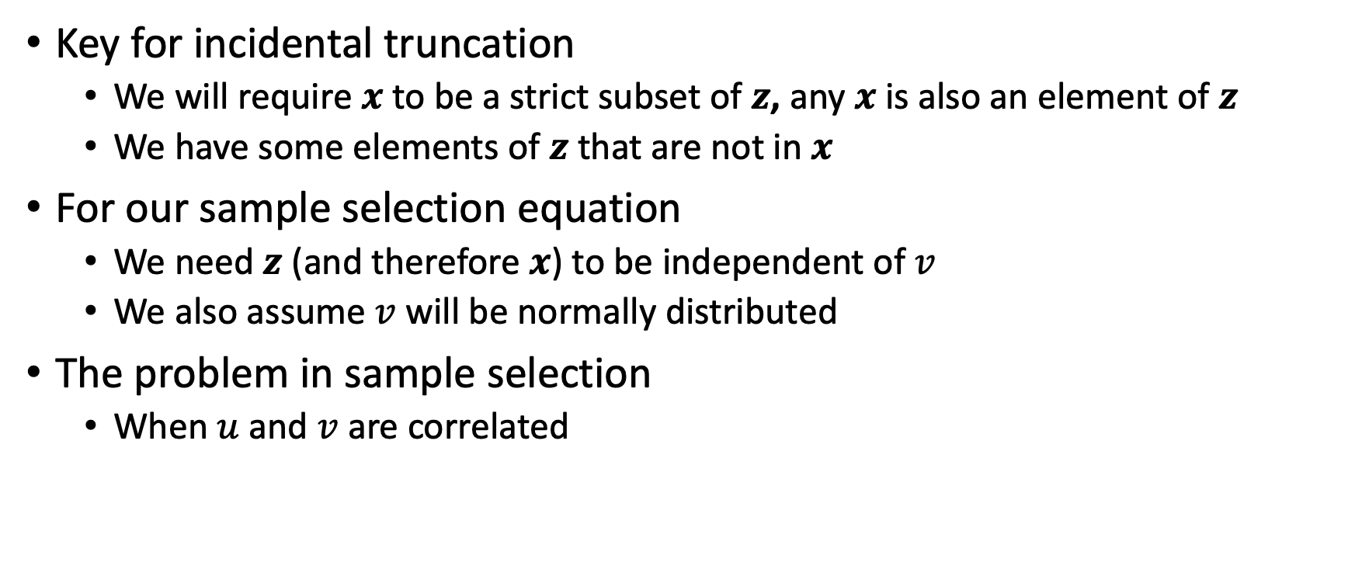
Incidental Truncation
Key for incidental truncation
We will require $x$ to be a strict subset of $z$, any $x$ is also an element of $z$
We have some elements of $z$ that are not in $x$
For our sample selection equation
We need $z$ (and therefore $x$) to be independent of $v$
We also assume $v$ will be normally distributed
The problem in sample selection
When $u$ and $v$ are correlated

Slide 58
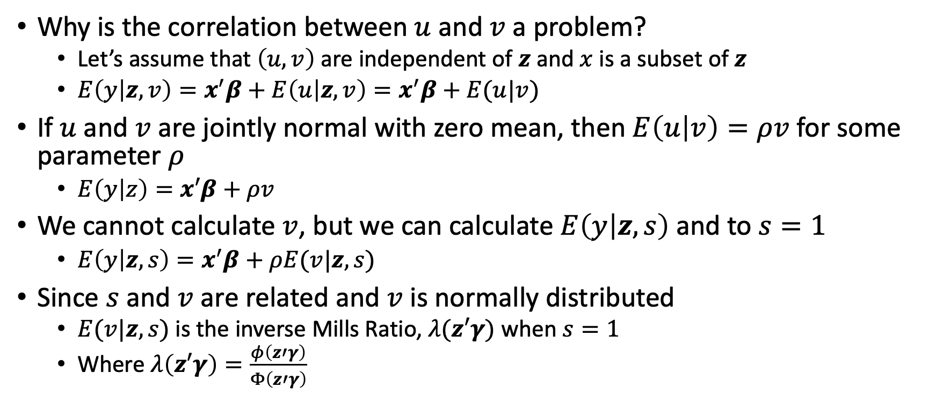
Incidental Truncation
Why is the correlation between $u$ and $v$ a problem?
Let’s assume that $\left(u,v\right)$ are independent of $z$ and $x$ is a subset of $z$
$E\left(y | z,v\right)=x^{′}β+E\left(u | z,v\right)=x^{′}β+E(u|v)$
If $u$ and $v$ are jointly normal with zero mean, then $E\left(u | v\right)=ρv$ for some parameter $ρ$
$E\left(y | z\right)=x′β+ρv$
We cannot calculate $v$, but we can calculate $E\left(y | z,s\right)$ and to $s=1$
$E\left(y | z,s\right)=x^{′}β+ρE(v|z,s)$
Since $s$ and $v$ are related and $v$ is normally distributed
$E(v|z,s)$ is the inverse Mills Ratio, $λ(z′γ)$ when $s=1$
Where $λ\left(z′γ\right)=\frac{φ\left(z′γ\right)}{Φ\left(z′γ\right)}$

Slide 59
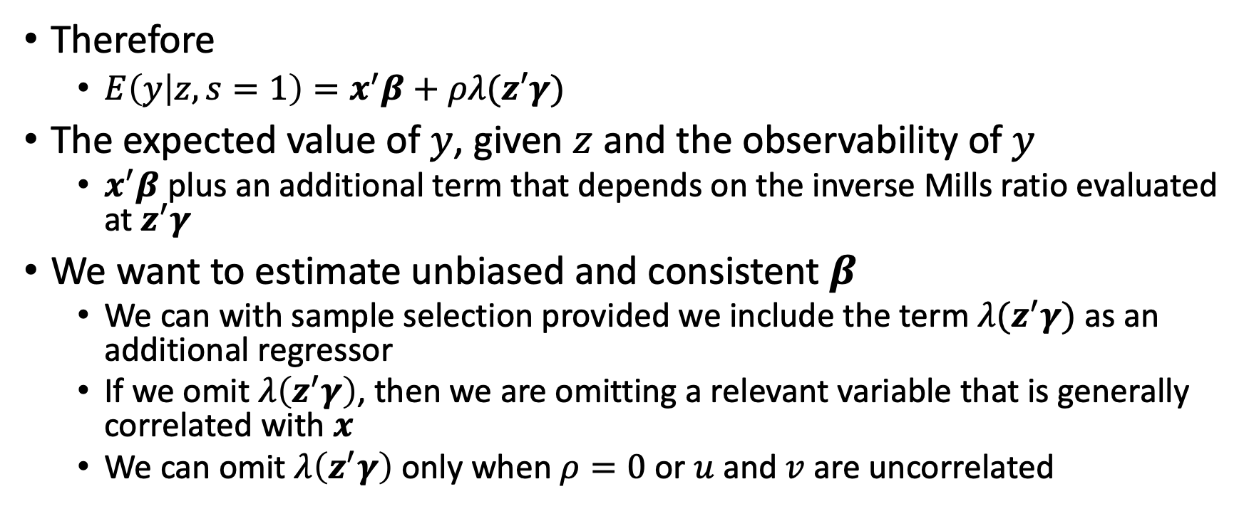
Incidental Truncation
Therefore
$E\left(y | z,s=1\right)=x^{′}β+ρλ(z′γ)$
The expected value of $y$, given $z$ and the observability of $y$
$x^{′}β$ plus an additional term that depends on the inverse Mills ratio evaluated at $z^{′}γ$
We want to estimate unbiased and consistent $β$
We can with sample selection provided we include the term $λ(z^{′}γ)$ as an additional regressor
If we omit $λ\left(z^{′}γ\right)$, then we are omitting a relevant variable that is generally correlated with $x$
We can omit $λ\left(z^{′}γ\right)$ only when $ρ=0$ or $u$ and $v$ are uncorrelated

Slide 60
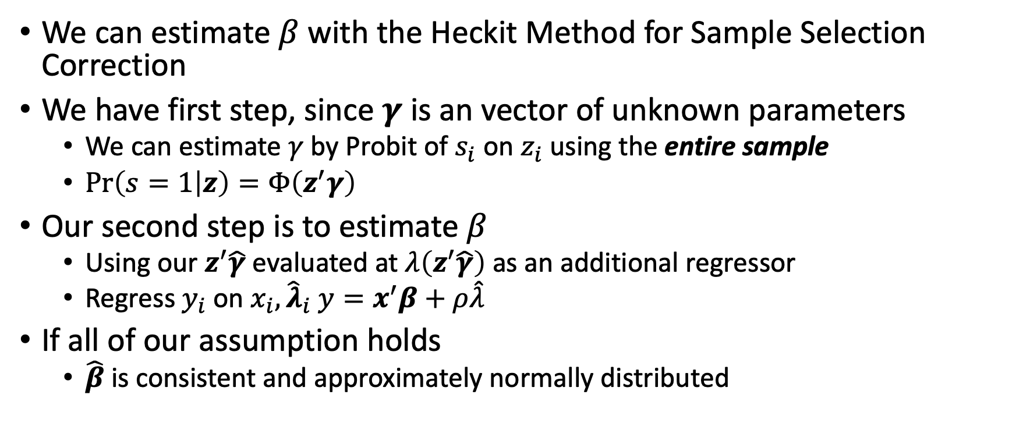
Heckit Method
We can estimate $β$ with the Heckit Method for Sample Selection Correction
We have first step, since $γ$ is an vector of unknown parameters
We can estimate $γ$ by Probit of $s_{i}$ on $z_{i}$ using the entire sample
$\operatorname{Pr}\left(s=1 | z\right)=Φ\left(z^{′}γ\right)$
Our second step is to estimate $β$
Using our $z^{′}\hat{γ}$ evaluated at $λ\left(z^{′}\hat{γ}\right)$ as an additional regressor
Regress $y_{i}$ on $x_{i}, {\hat{λ}}_{i}$ $y=x^{′}β+ρ\hat{λ}$
If all of our assumption holds
$\hat{β}$ is consistent and approximately normally distributed

Slide 61
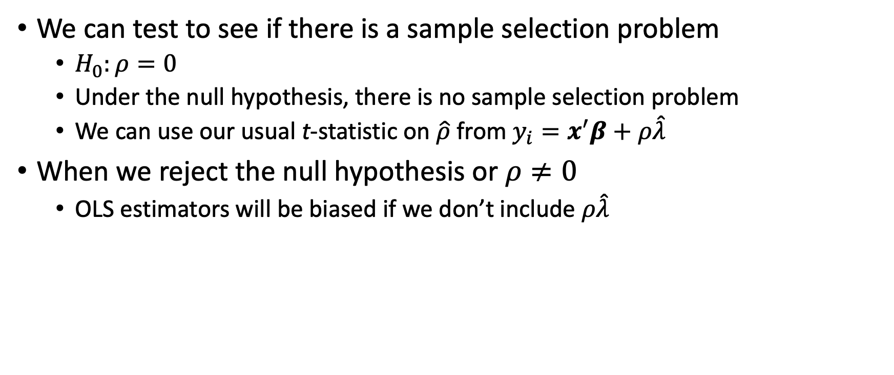
Heckit Method
We can test to see if there is a sample selection problem
$H_{0}:ρ=0$
Under the null hypothesis, there is no sample selection problem
We can use our usual t-statistic on $\hat{ρ}$ from $y_{i}=x^{′}β+ρ\hat{λ}$
When we reject the null hypothesis or $ρ≠0$
OLS estimators will be biased if we don’t include $ρ\hat{λ}$

Slide 62
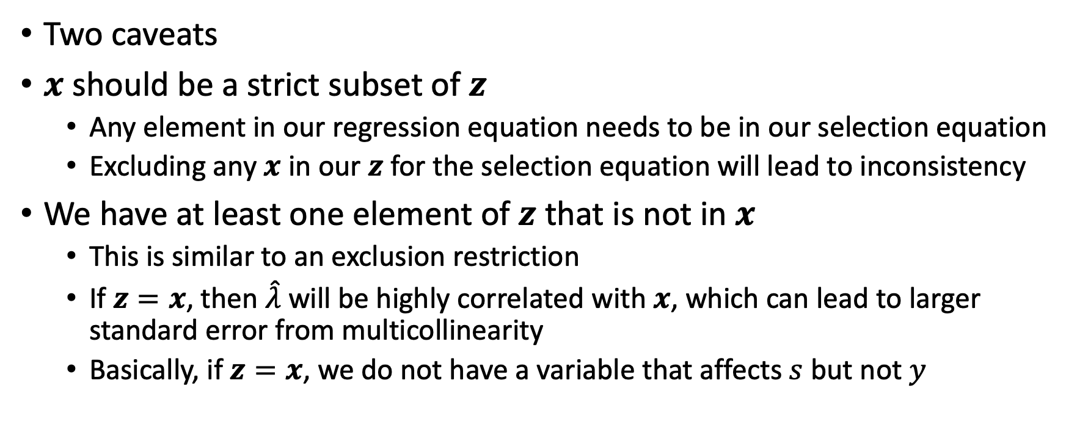
Heckit Method
Two caveats
$x$ should be a strict subset of $z$
Any element in our regression equation needs to be in our selection equation
Excluding any $x$ in our $z$ for the selection equation will lead to inconsistency
We have at least one element of $z$ that is not in $x$
This is similar to an exclusion restriction
If $z=x$, then $\hat{λ}$ will be highly correlated with $x$, which can lead to larger standard error from multicollinearity
Basically, if $z=x$, we do not have a variable that affects $s$ but not $y$

Slide 63
Stata

